Slide 1
Wave particle duality and the quantum theory
Reflection
Refraction
Polarization
Interference
Diffraction
Electromagnetic waves
Blackbody radiation
Photoelectric effect
Compton scattering
De Broglie wavelength
Atomic absorption and emission
Energy level diagrams
Fluorescence and phosphorescence
Lasers
Stellar spectra
Photovoltaic cells
LEDs
X-ray generation

Slide 2

SCSA ATAR Syllabus
(last updated 29/11/19; https://senior-secondary.scsa.wa.edu.au/syllabus-and-support-materials/science/physics)
Science Understanding
light exhibits many wave properties; however, it cannot only be modelled as a mechanical wave because it can travel through a vacuum
a wave model explains a wide range of light-related phenomena, including reflection, refraction, dispersion, diffraction and interference; a transverse wave model is required to explain polarization
electromagnetic waves are transverse waves made up of mutually perpendicular, oscillating electric and magnetic fields
oscillating charges produce electromagnetic waves of the same frequency as the oscillation; electromagnetic waves cause charges to oscillate at the frequency of the wave
atomic phenomena and the interaction of light with matter indicate that states of matter and energy are quantized into discrete values
on the atomic level, electromagnetic radiation is emitted or absorbed in discrete packets called photons. The energy of a photon is proportional to its frequency. The constant of proportionality, Planck’s constant, can be determined experimentally using the photoelectric effect and the threshold voltage of coloured LEDs
This includes applying the relationships
$$c=fλ, E=hf=\frac{hc}{λ}, E_{k}=hf−W, de Broglie λ=\frac{h}{p}$$
a wide range of phenomena, including black body radiation and the photoelectric effect, are explained using the concept of light quanta
atoms of an element emit and absorb specific wavelengths of light that are unique to that element; this is the basis of spectral analysis
This includes applying the relationships
$$ΔE=hf, E_{2}−E_{1}=hf$$
the Bohr model of the hydrogen atom integrates light quanta and atomic energy states to explain the specific wavelengths in the hydrogen spectrum and in the spectra of other simple atoms; the Bohr model enables line spectra to be correlated with atomic energy-level diagrams
on the atomic level, energy and matter exhibit the characteristics of both waves and particles. Young’s double slit experiment is explained with a wave model but produces the same interference and diffraction patterns when one photon at a time or one electron at a time are passed through the slits
Science as a Human Endeavour
Models that were initially rejected can be revisited as more evidence becomes available. For many years, the presence of luminiferous ether was proposed as the medium by which light is propagated. Around 1800, Thomas Young showed through experimentation that light passing through a double slit showed interference and thus wave properties. The wave explanation of Young’s double slit demonstration was initially rejected until other physicists, including Fresnel and Poisson, showed that light was able to undergo diffraction, a property of waves. Later, in the 1860s, James Clerk Maxwell developed a theory of electromagnetism and showed that electromagnetic waves would travel through space at the speed of light, implying light was an electromagnetic wave.
The use of devices developed from the application of quantum physics, including the laser and photovoltaic cells, have significantly changed many aspects of society.

Slide 3
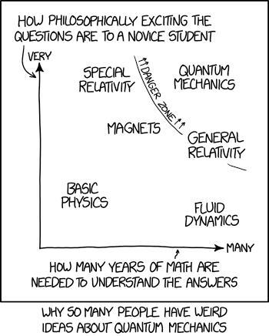
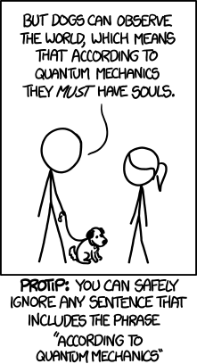

Slide 4
Is light a wave or a particle
Wave behaviour | Explained by wave? | Explained by particle?
Reflection | Yes | Yes
Refraction | Yes | Yes
Polarization | Yes | (Yes)
Interference | Yes | No
Diffraction | Yes | No
Photoelectric effect | No | Yes
Compton scattering | No | Yes

Slide 5
Light – confused identity
Some of light’s behaviour can be explained with either a wave or particle model for light. However, some requires that it is a particle, and some requires that it is a wave.
The question remains; is light a wave or a particle?
Is it both at all times?
Is it sometimes one, and sometimes the other?
Close examination of the behaviour of light in different contexts is needed to deepen our understanding

Slide 6
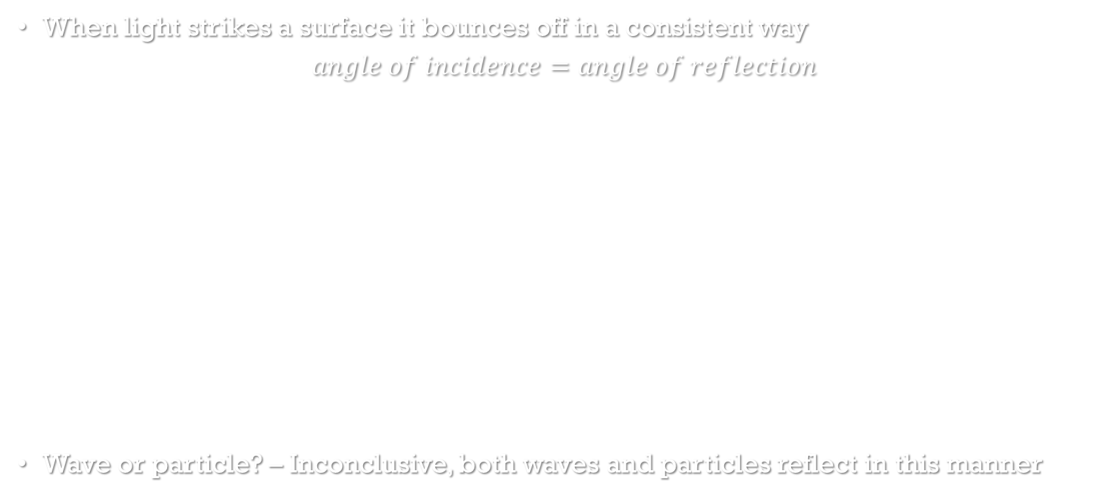
Light behaviour - reflection
When light strikes a surface it bounces off in a consistent way
$$angle of incidence=angle of reflection$$
Wave or particle? – Inconclusive, both waves and particles reflect in this manner
Incident ray
Reflected ray
Normal
Angle of incidence
Angle of reflection

Slide 7
Light Behaviour - Refraction
A change in speed of light as it enters a new medium at an angle causes light to bend
The change in speed is accompanied by a change in wavelength as frequency remains constant
If light speeds up, it will bend away from the normal
If light slows down, it will bend towards the normal
Remember FAST - Fast Away Slow Towards
Wave or particle? – Inconclusive, while typically thought of as wave behaviour, it can be explained by the particle model e.g. marching band cornering, car changing surfaces at an angle
slow
fast
normal
surface

Slide 8
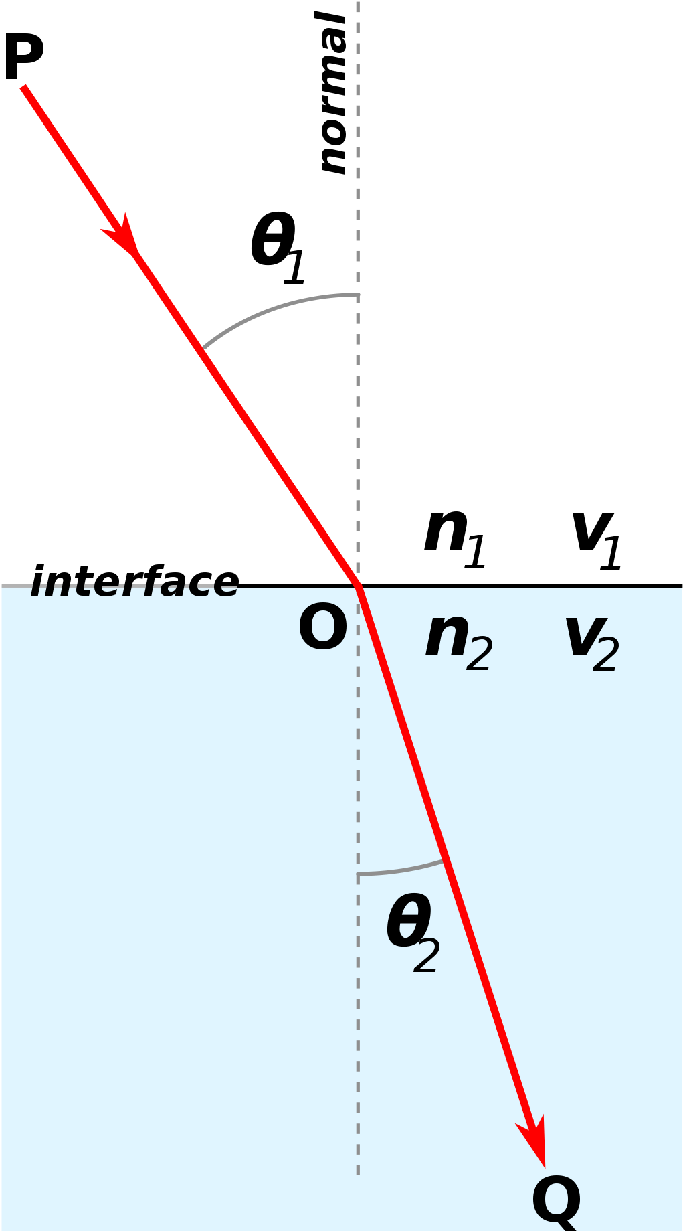
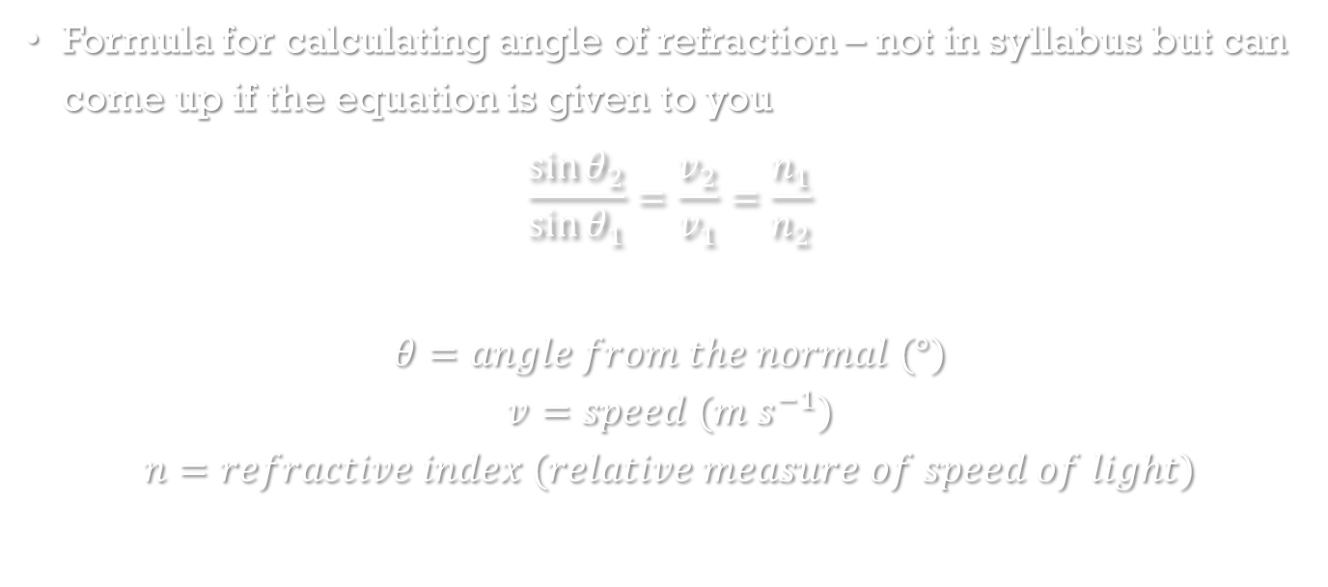
Sidebar – Snell’s law
Formula for calculating angle of refraction – not in syllabus but can come up if the equation is given to you
$$\frac{\sin{θ_{2}}}{\sin{θ_{1}}}=\frac{v_{2}}{v_{1}}=\frac{n_{1}}{n_{2}}$$
$$θ=angle from the normal (°)$$
$$v=speed (m s^{−1})$$
$$n=refractive index (relative measure of speed of light)$$

Slide 9

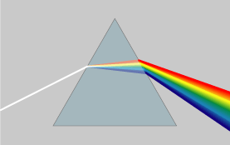
Dispersion
As white light (mixture of all colours) is refracted, the different colours refract different amounts – spreads out the colours
Shorter wavelength (more blue) light bends more

Slide 10
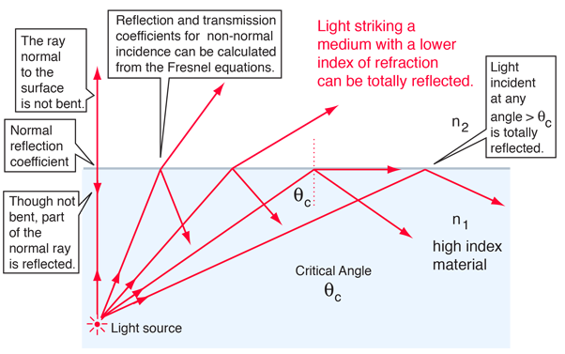
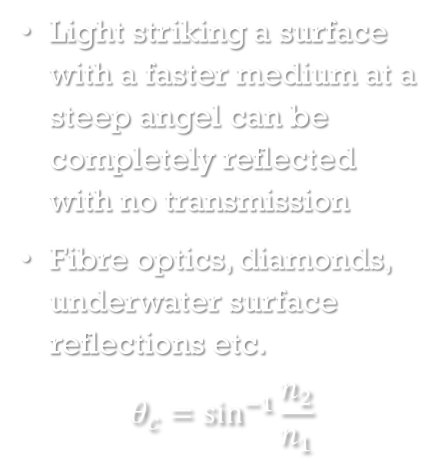
Total internal reflection
Light striking a surface with a faster medium at a steep angel can be completely reflected with no transmission
Fibre optics, diamonds, underwater surface reflections etc.
$$θ_{c}=\sin^{−1}{\frac{n_{2}}{n_{1}}}$$

Slide 11
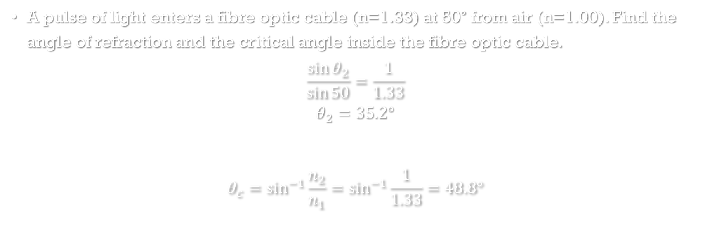
Example
A pulse of light enters a fibre optic cable (n=1.33) at 50° from air (n=1.00). Find the angle of refraction and the critical angle inside the fibre optic cable.
$$\frac{\sin{θ_{2}}}{\sin{50}}=\frac{1}{1.33}$$
$$θ_{2}=35.2°$$
$$θ_{c}=\sin^{−1}{\frac{n_{2}}{n_{1}}}=\sin^{−1}{\frac{1}{1.33}}=48.8°$$

Slide 12
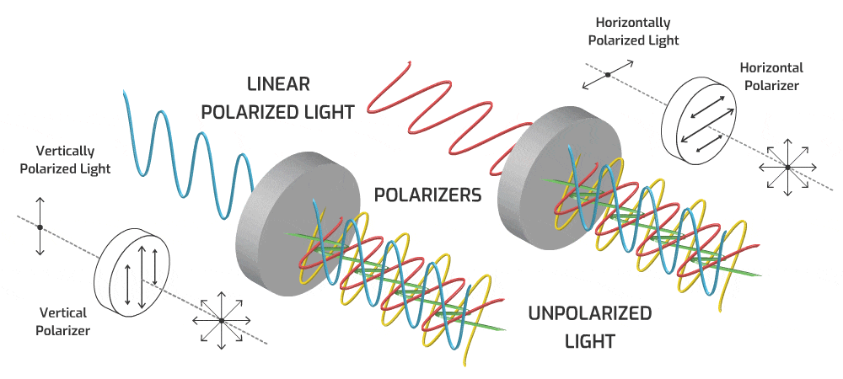
Polarization
Oscillation of light’s electric
and magnetic fields are
always perpendicular to
the direction of propagation
(transverse wave) but they
can be at any rotation
Light can be filtered to only
allow light of a specific
orientation through
Wave or particle? – Most simply and intuitively explained by light as a wave (specifically a transverse wave) but quantum mechanics relates polarization to photon spin allowing for a particle interpretation

Slide 13
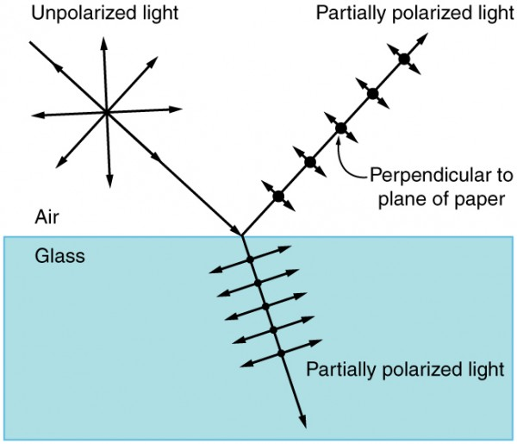
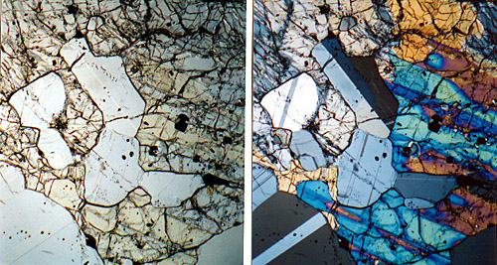
Polarization applications
Polarization occurs naturally when light reflects off non-metallic surfaces – the light is partially polarized in the horizontal direction
Vertically polarized sunglasses can then selectively filter out reflected glare off water and snow etc.
Two polarizing filters at right angles should block
all light
Some materials rotate the polarization of light or
interact with polarization in other ways – allows
for optical analysis of rocks, stressed materials etc.

Slide 14
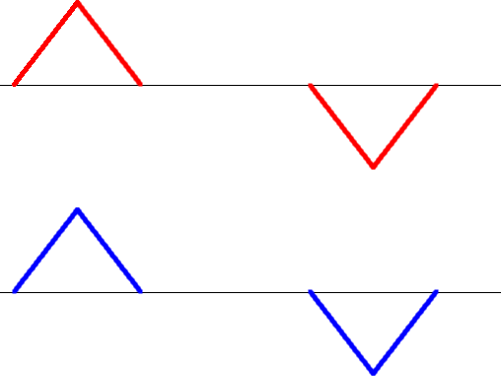

Interference - Superposition
When two waves overlap, they interfere
Can be thought of as a vector sum of the two waves
The waves pass through each other unchanged
If the waves are out of phase (i.e. peak meeting trough) then
destructive interference occurs (decreased amplitude)
If the waves are in phase (i.e. peak meeting peak) then
constructive interference occurs (increased amplitude)
Wave or particle? – Interference is fundamentally a wave
behaviour

Slide 15
Interference in two dimensions
Complex patterns emerge with interference in 2D
Wavefronts show crests, troughs centered between wavefronts
Zones of constructive interference (antinodal lines) in red, zone of destructive interference (nodal lines) in-between

Slide 16
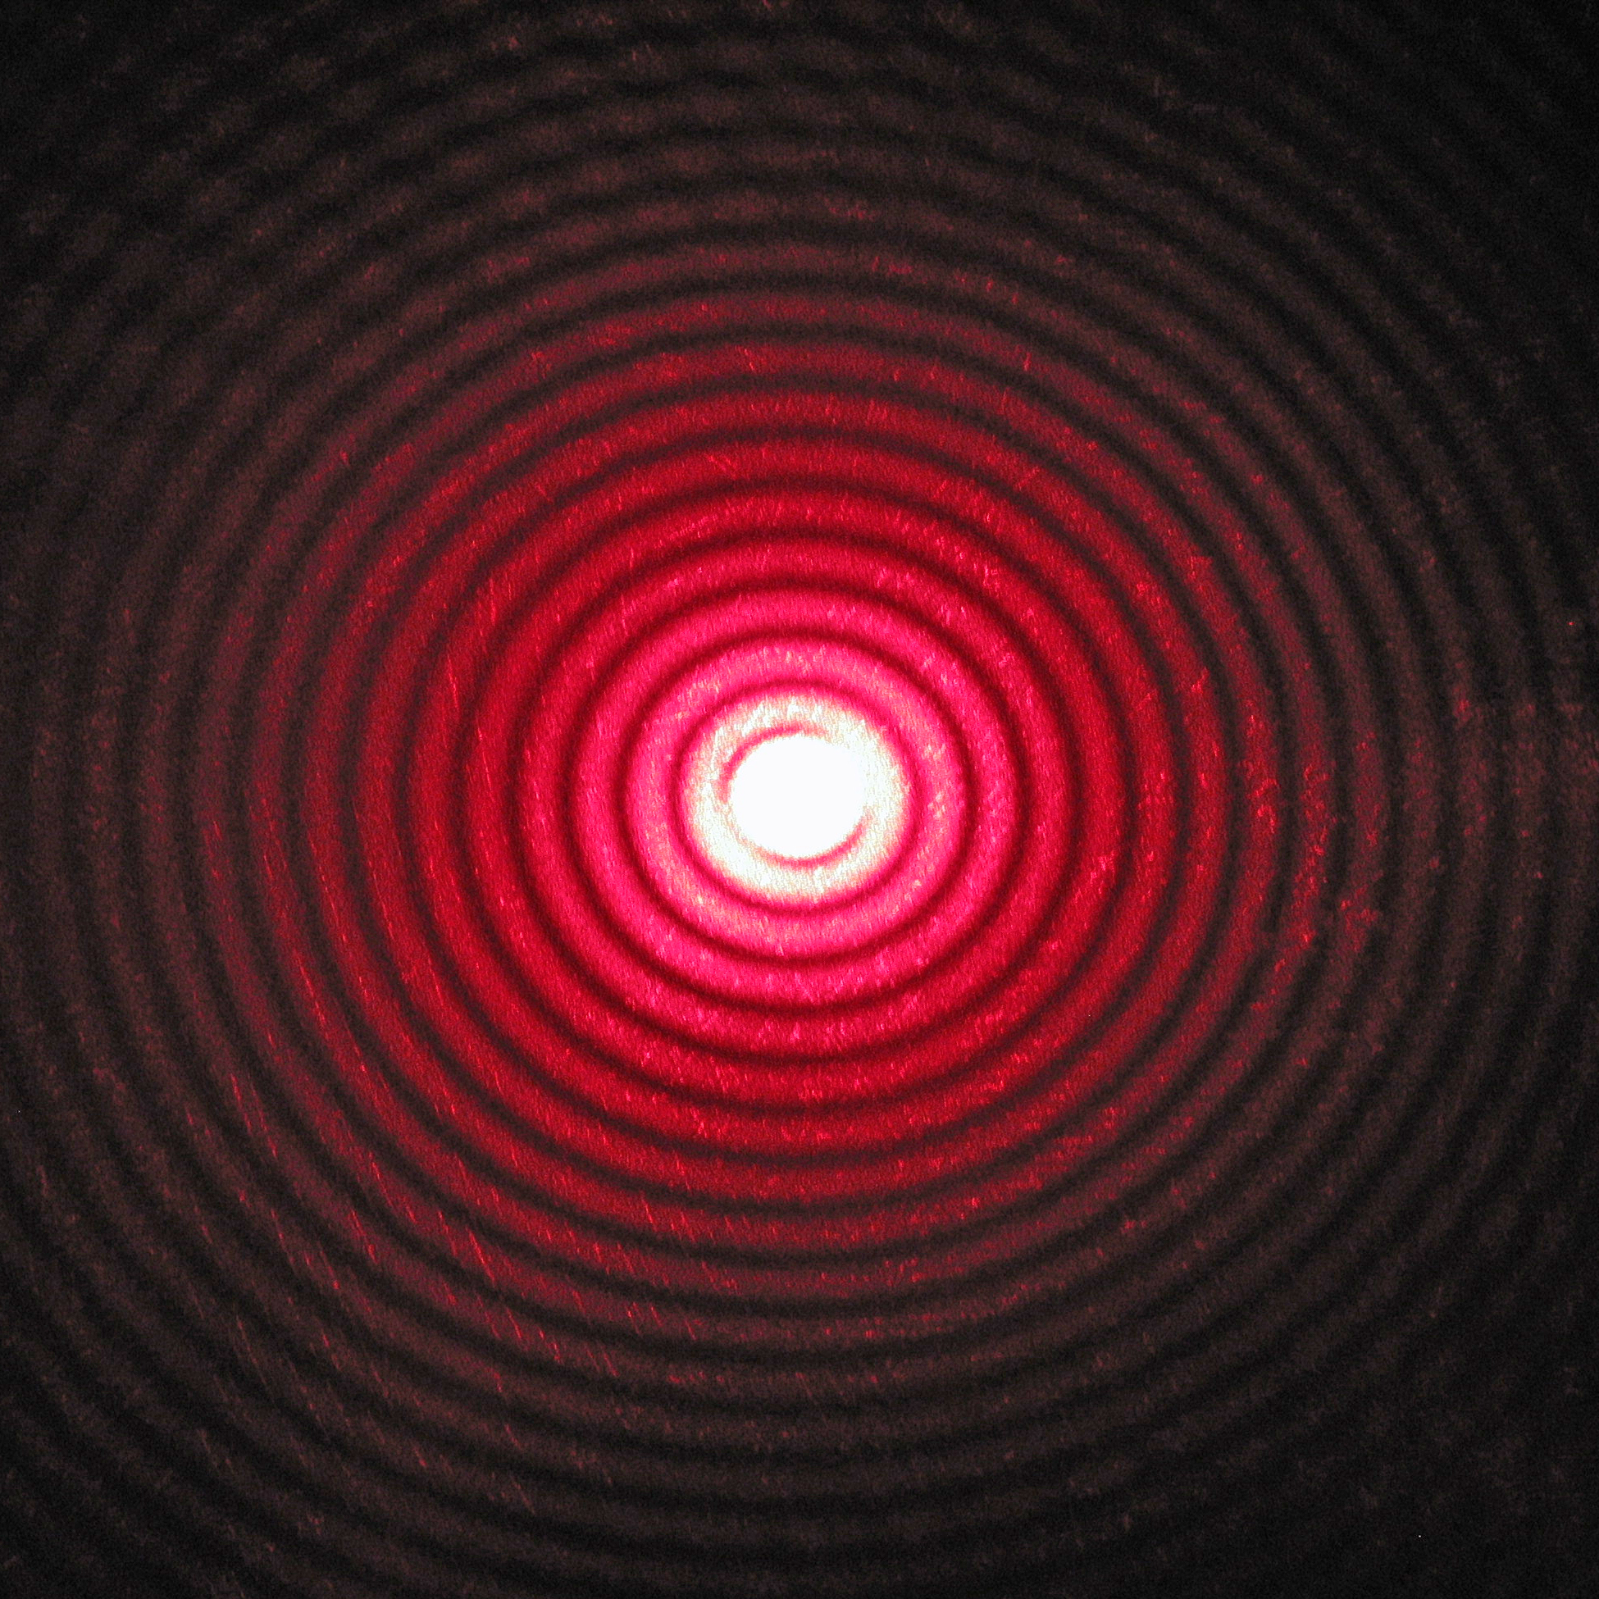
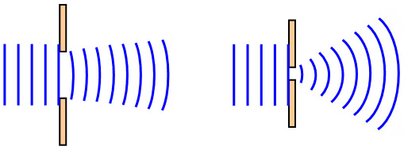
Diffraction
Bending of light around the corners of an obstacle or as it passes
through a gap – result of interference (two words sometimes used
interchangeably – can get messy)
The smaller the gap, the more the waves bends
The larger the wavelength, the more the waves bend
Only significant when wavelength is approaching the same size as the
gap (or is bigger)
With strong diffraction the gap functions as a new
point source for the wave
Wave or particle? – Diffraction is fundamentally a
wave behaviour – alarming that electrons and
even neutrons have also been shown to diffract…

Slide 17
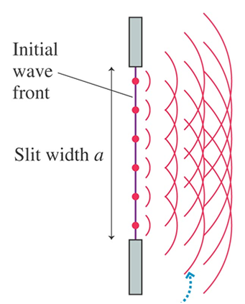
Explaining Diffraction
Huygen’s principle – every point on a wavefront can be through of as a point source
All of these point sources interfere to create the wavefronts that we observe
When part of a wavefront is obstructed, the end of the wavefront next to the obstacle can be seen acting like a point source because there is no interference from the rest of the wavefront that is obstructed
Results in the wave appearing to bend around corners

Slide 18
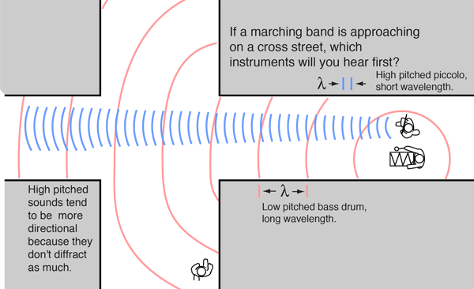
example
You will hear the bass drum first – the longer wavelength wave will bend more around corners

Slide 19
Example
If light is a wave that diffracts, why can we not see around corners?
The wavelength of visible light is around about 0.1 μm, so it will only appreciably diffract through gaps of roughly that size or smaller – not relevant to our everyday lives

Slide 20
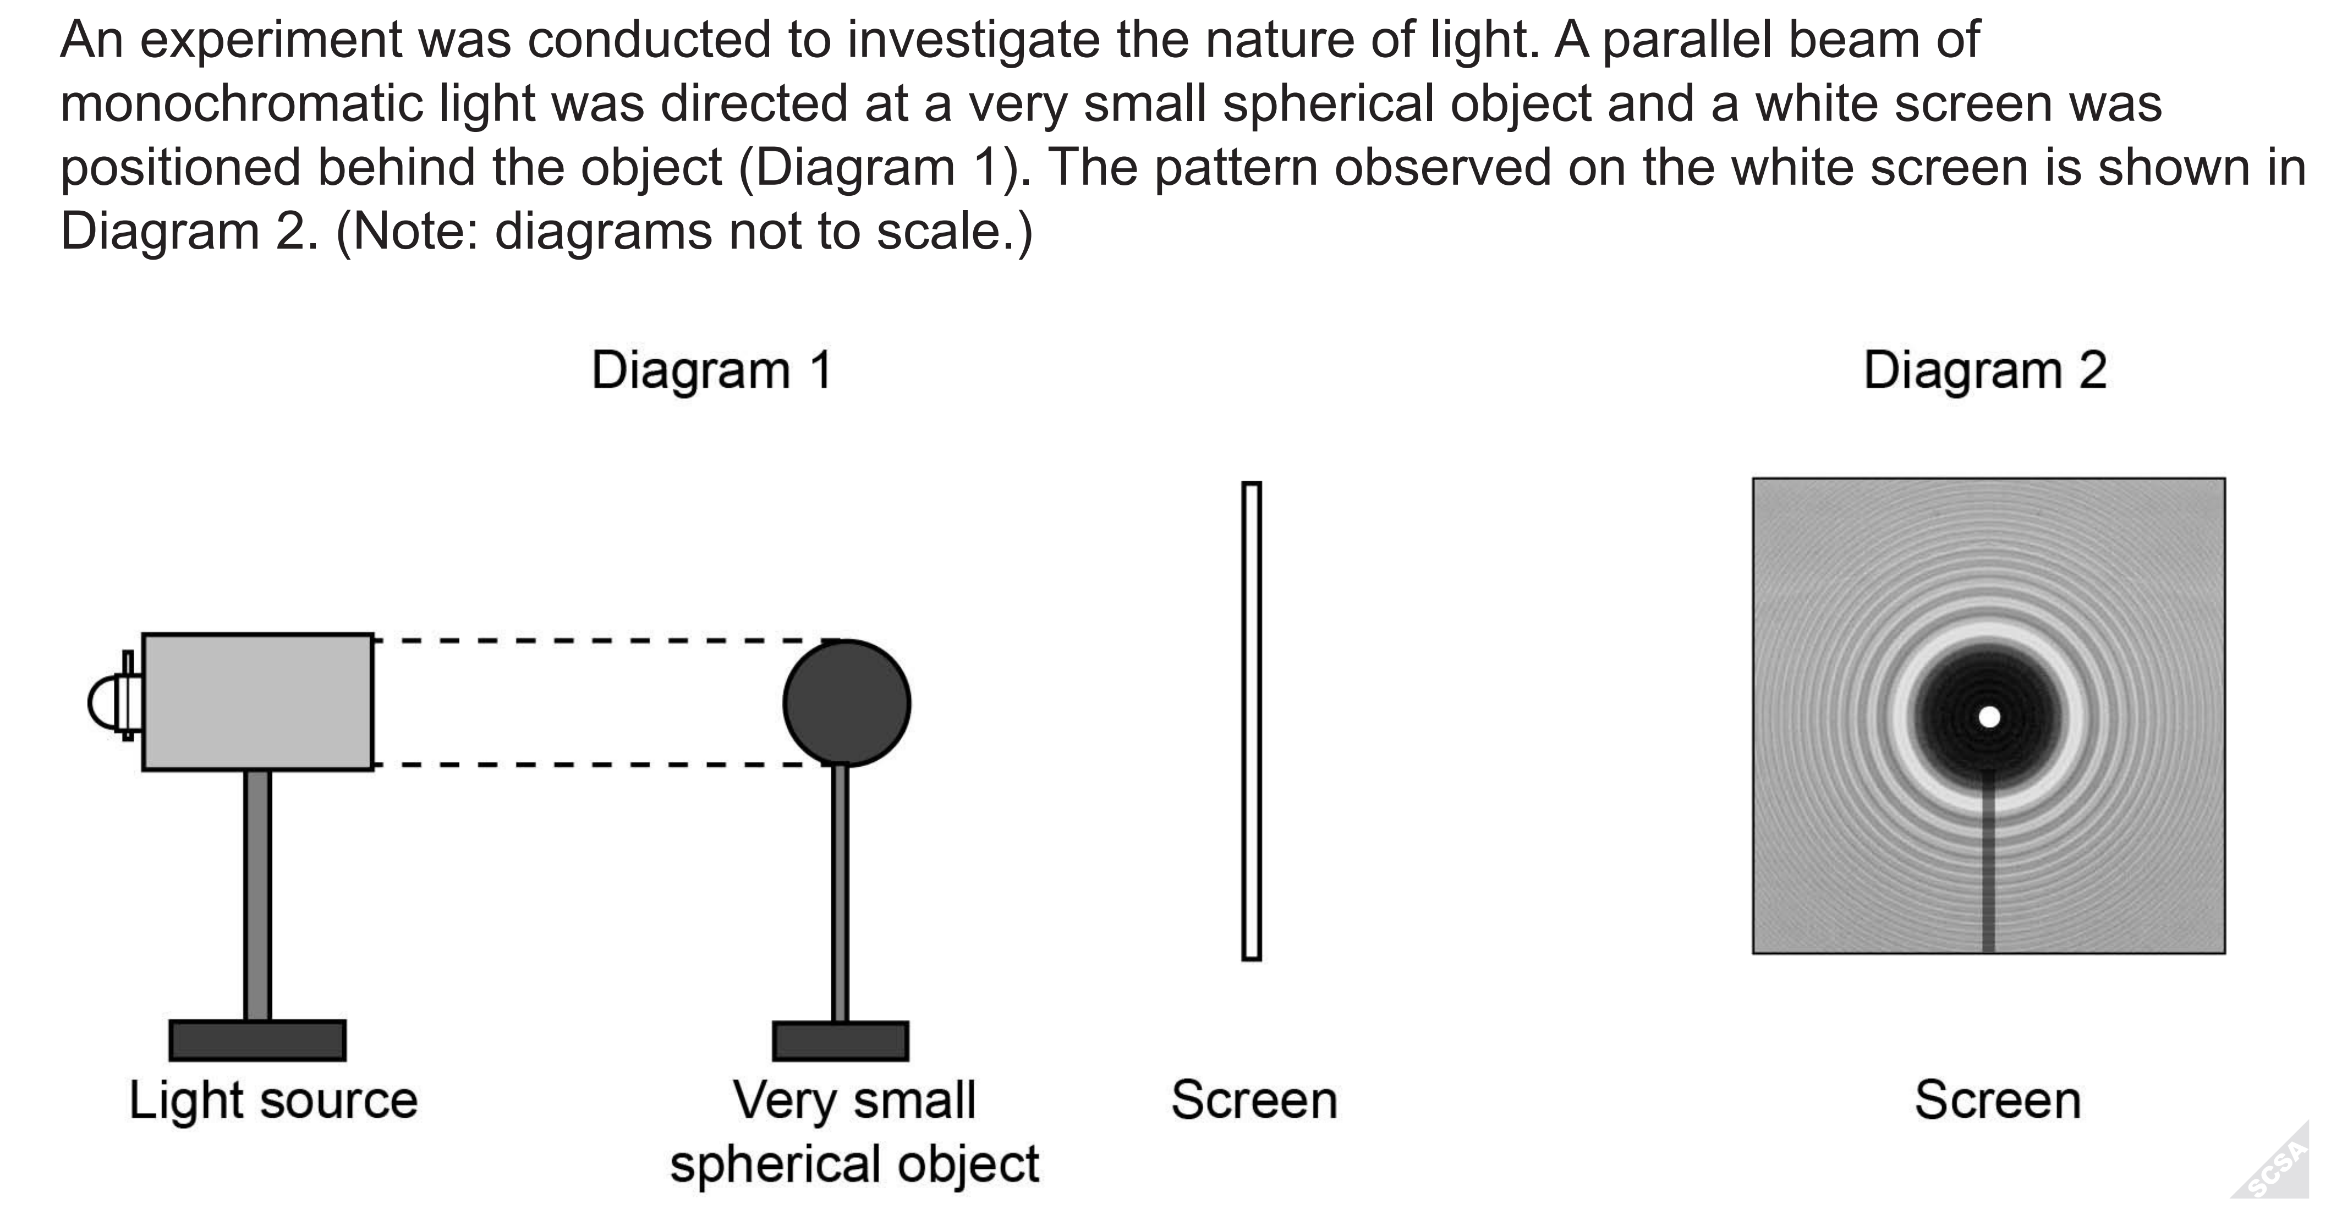
ATAR example
Discuss how the pattern in Diagram 2 was formed.
From this experiment what conclusion can be made regarding light?

Slide 21
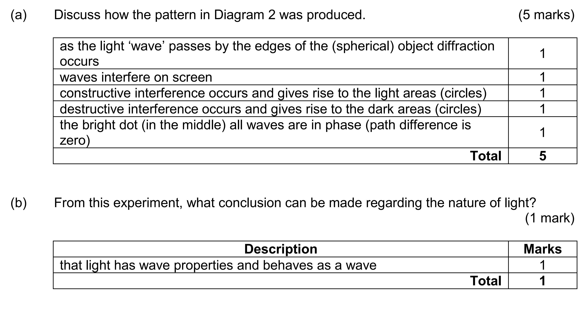

Slide 22
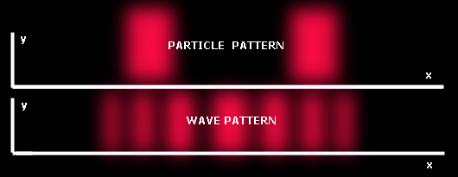
Wave or Particle? – Double slit experiment
Light shone at barrier with two small slits – resulting pattern of light on the other side of the barrier observed
If light is a particle then it should only be visible on the other side of the barrier directly in line with the slits
If light is a wave then an interference pattern should be visible cause by diffraction
intensity

Slide 23
Double slit experiment - result
With the right slit diameter, the light diffracts from each slit – each slit behaves like a point source
Light from the two slits interferes creating alternating bands of constructive and destructive interference – alternating bands of high and low intensity referred to as fringes
Bright fringes numbers from 0th in the center increasing out in both directions
Wave or particle? – Diffraction is fundamentally a wave behaviour
intensity

Slide 24
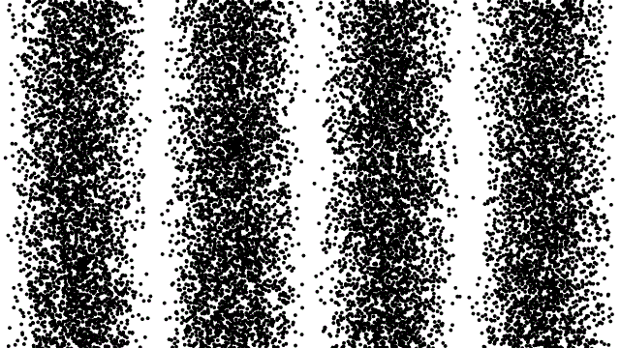
Double slit experiment – one ‘particle’ at a time
If the experiment is repeated only firing a single electron or photon at a time, the behaviour of the particles appears strange
They do not follow the expected particle pattern, instead as more particles pass through it becomes clear that the wave pattern is forming
Particles even as large as buckyballs (C₆₀) must have a wave nature and even a wavelength

Slide 25
Double-slit experiment - Path difference
Effectively have two in-phase point sources interfering with each other – at points where waves arrive in phase constructive interference occurs, at points where the waves arrive exactly out of phase (referred to as 180° out of phase) destructive interference occurs
The phase relationship at a point in space is determine by the path difference between the two waves – the difference between the distances the two waves must travel to reach that point
If the path difference is an integer multiple of the wavelength then the waves arrive perfectly in phase - constructive interference occurs
If the phase difference is a half-integer multiple of the wavelength then the waves arrive 180° out of phase – destructive interference occurs

Slide 26
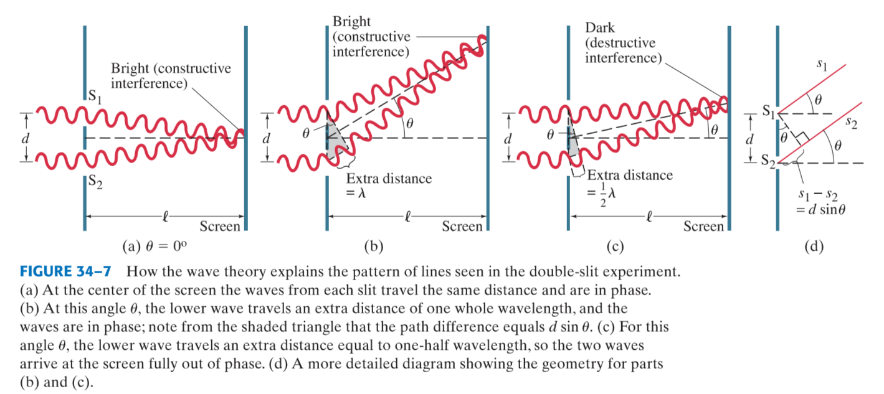

Slide 27

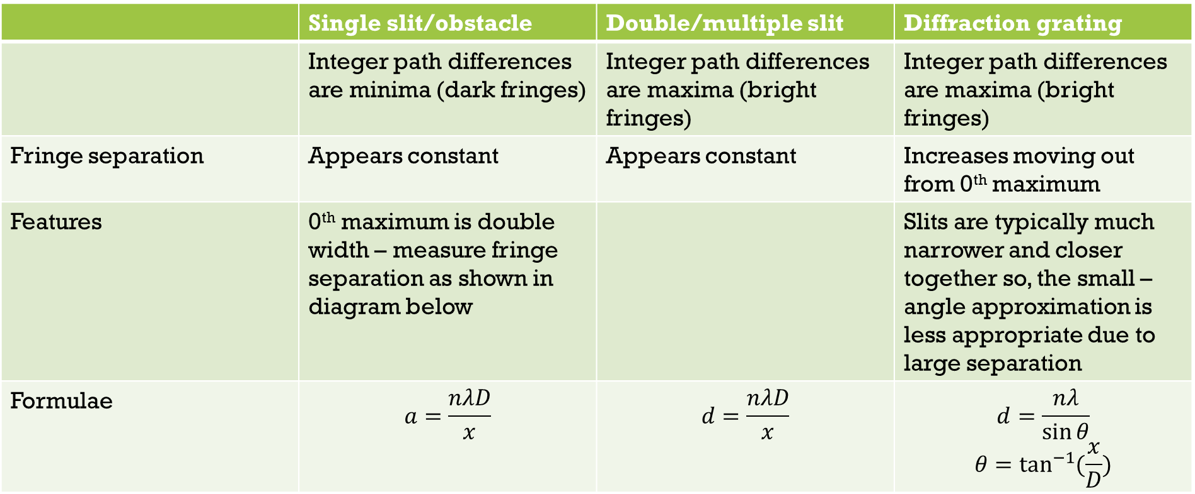


Variations on Double slit
 | Single slit/obstacle | Double/multiple slit | Diffraction grating
 | Integer path differences are minima (dark fringes) | Integer path differences are maxima (bright fringes) | Integer path differences are maxima (bright fringes)
Fringe separation | Appears constant | Appears constant | Increases moving out from 0th maximum
Features | 0th maximum is double width – measure fringe separation as shown in diagram below |  | Slits are typically much narrower and closer together so, the small –angle approximation is less appropriate due to large separation
Formulae | $$a=\frac{nλD}{x}$$ | $$d=\frac{nλD}{x}$$ | $$d=\frac{nλ}{\sin{θ}}$$ $$θ=\tan^{−1}{(\frac{x}{D})}$$
$$x$$
$$x$$
$$x$$
0th
0th
0th

Slide 28
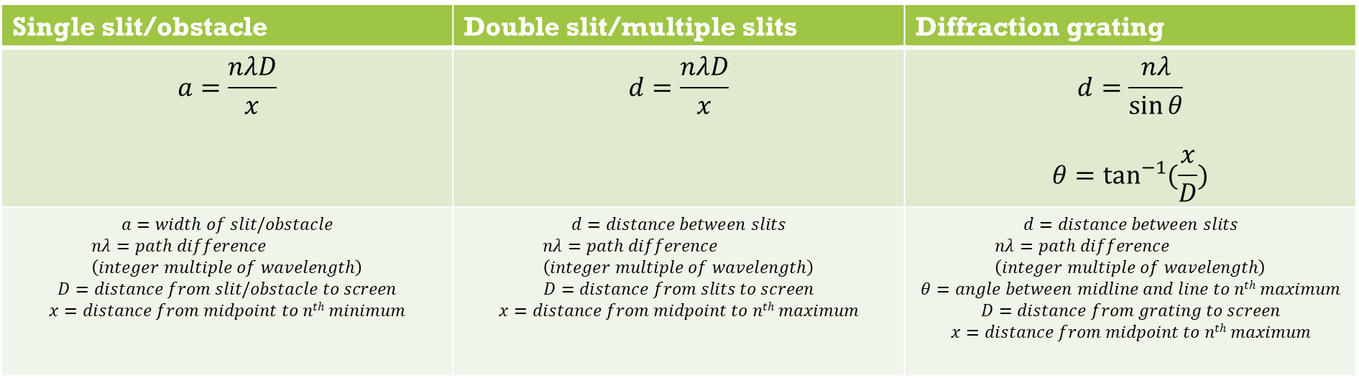
x
θ
θ
d
D
nλ
Single slit/obstacle | Double slit/multiple slits | Diffraction grating
$$a=\frac{nλD}{x}$$ | $$d=\frac{nλD}{x}$$ | $$d=\frac{nλ}{\sin{θ}}$$ $$θ=\tan^{−1}{(\frac{x}{D})}$$
$$a=width of slit/obstacle$$ $$nλ=path difference \\ \left(integer multiple of wavelength\right)$$ $$D=distance from slit/obstacle to screen$$ $$x=distance from midpoint to nth minimum$$ | $$d=distance between slits$$ $$nλ=path difference \\ \left(integer multiple of wavelength\right)$$ $$D=distance from slits to screen$$ $$x=distance from midpoint to nth maximum$$ | $$d=distance between slits$$ $$nλ=path difference \\ \left(integer multiple of wavelength\right)$$ $$θ=angle between midline and line to nth maximum$$ $$D=distance from grating to screen$$ $$x=distance from midpoint to nth maximum$$

Slide 29
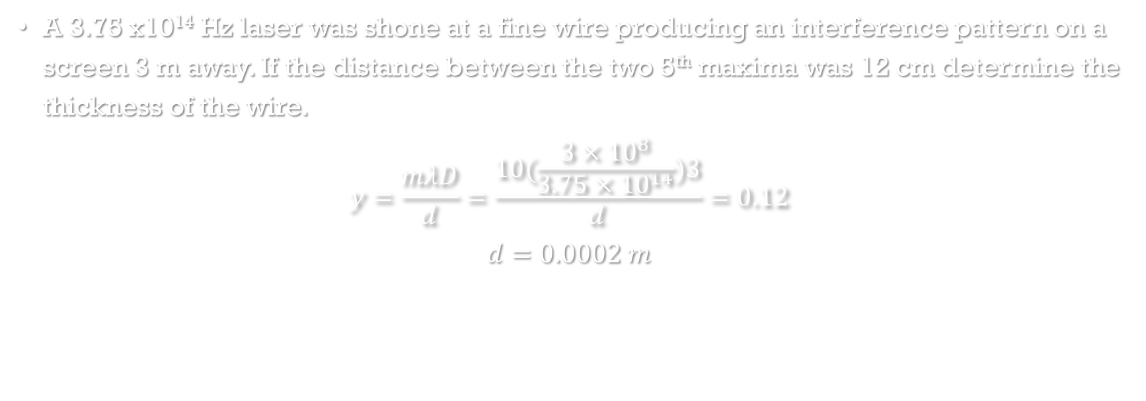
Example
A 3.75 x10¹⁴ Hz laser was shone at a fine wire producing an interference pattern on a screen 3 m away. If the distance between the two 5th maxima was 12 cm determine the thickness of the wire.
$$y=\frac{mλD}{d}=\frac{10(\frac{3×{10}^{8}}{3.75×{10}^{14}})3}{d}=0.12$$
$$d=0.0002 m$$

Slide 30
Travel through a vacuum
Light is able to travel through a vacuum with no medium to carry it
Wave or particle? – Can be a particle, cannot be a mechanical wave – special type of wave required – electromagnetic wave

Slide 31
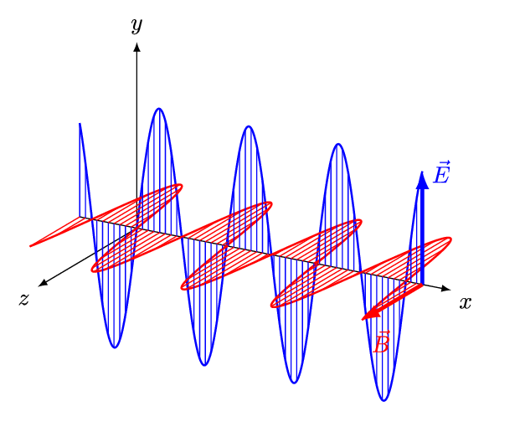
Light as electromagnetic waves
So far light can be explained as a self-propagating electromagnetic wave
A pair or perpendicular oscillating electric and magnetic fields
Direction of oscillation is perpendicular to the direction of propagation – transverse wave
Transmits energy (without transmitting matter)

Slide 32

Wave equation
$$c=fλ$$
$$c=speed of light=3×{10}^{8} \left(m s^{−1}\right)$$
$$f=frequency \left(Hz=s^{−1}\right)$$
$$λ=wavelength \left(m\right)$$
$$\frac{1}{f}=T=period (s)$$

Slide 33
Wave characteristics
Frequency: number of waves passing a point each second
Period: The time it takes for a wave to repeat itself
Wavelength: length of 1 complete wave
Amplitude: the largest magnitude of the oscillation in the electric or magnetic fields

Slide 34
Electromagnetic spectrum
Light’s properties vary over a spectrum
Radio waves, microwaves, infrared radiation, visible light, ultraviolet radiation, X-rays and gamma rays are all light - are all electromagnetic waves
They have varying properties due to varying frequency/wavelength
Bear in mind that since the speed of light is constant, a wave of a specific frequency must have a specific wavelength and vice versa

Slide 35
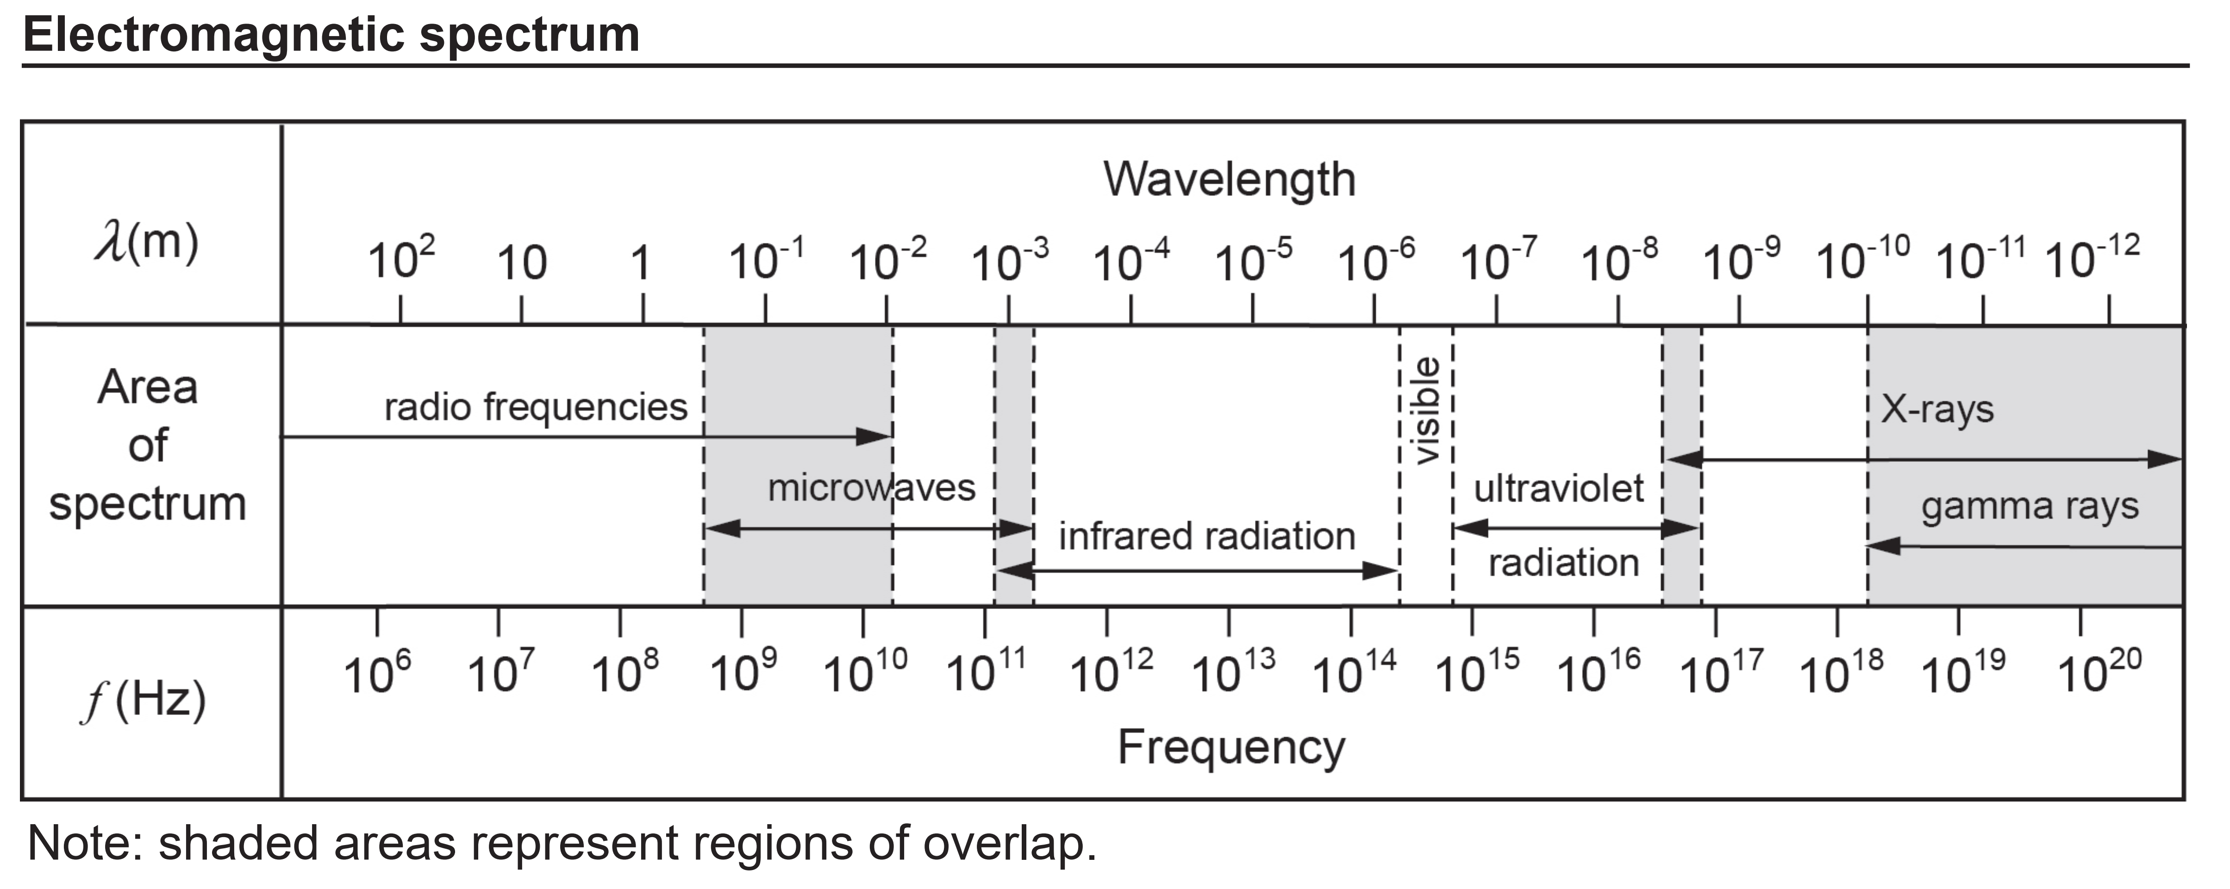
Use the spectrum above to estimate the frequency and wavelength of red light
4x10¹⁴ Hz and 7x10⁻⁷ m
This spectrum from the datasheet is not perfectly to scale (should be logarithmic scale) - most important thing is that the order of magnitude is correct (particularly tricky with wavelength – read right to left)

Slide 36
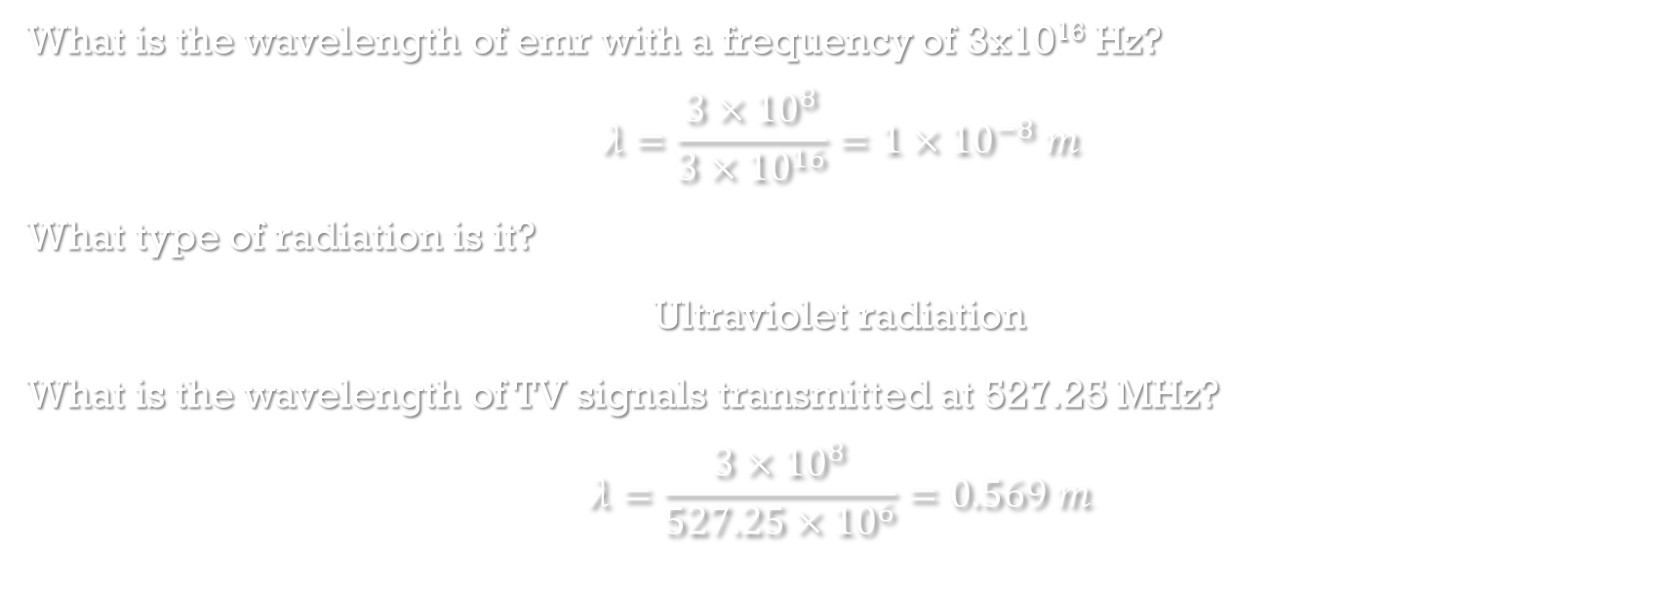
Examples
What is the wavelength of emr with a frequency of 3x10¹⁶ Hz?
$$λ=\frac{3×{10}^{8}}{3×{10}^{16}}=1×{10}^{−8} m$$
What type of radiation is it?
Ultraviolet radiation
What is the wavelength of TV signals transmitted at 527.25 MHz?
$$λ=\frac{3×{10}^{8}}{527.25×{10}^{6}}=0.569 m$$

Slide 37
Type | Wavelength (m) | Frequency (Hz) | Energy (J) | Source | Uses | Physiological effects
Gamma rays | <1x10⁻¹⁰ | >3x10¹⁸ | >2x10-¹⁵ | nuclear reactions, electron-positron annihilation | information about nuclear structure | cancer
X-rays | 1x10⁻¹³ - 6x10⁻⁹ | 6x10¹⁶ – 1x10²¹ | 4x10⁻¹⁷ – 7x10⁻¹³ | retardation of high energy electrons | medical imaging, crystallography | cancer
UV radiation | 3x10⁻⁹ - 3x10⁻⁷ | 8x10¹⁴ - 9x10¹⁶ | 5x10⁻¹⁹ – 6x10⁻¹⁷ | excitation of atoms | information about molecular and electron stucture | skin cancer, eye damage
Visible light | 3x10⁻⁷ - 8x10⁻⁷ | 4x10¹⁴ – 8x10¹⁴ | 3x10⁻¹⁹ – 5x10⁻¹⁹ | excitation of atoms | information about molecular and electron structure | eye damage
IR radiation | 8x10⁻⁷ - 2x10⁻³ | 1x10¹¹ - 4x10¹⁴ | 7x10⁻²³ -3x10⁻¹⁹ | excitation of atoms | information about molecular and electron structure | burns, eye damage
Microwaves | 8x10⁻⁴ - 5x10⁻¹ | 7x10⁸ - 2x10¹⁰ | 5x10⁻²⁵ – 1x10⁻²³ | oscillating currents in vacuum tube | radar, television, heating water | burns from heating of water
Radio waves | >9x10⁻³ | <3x10¹⁰ | <2x10⁻²³ | oscillating circuits | radio communication, television | burns from heating

Slide 38
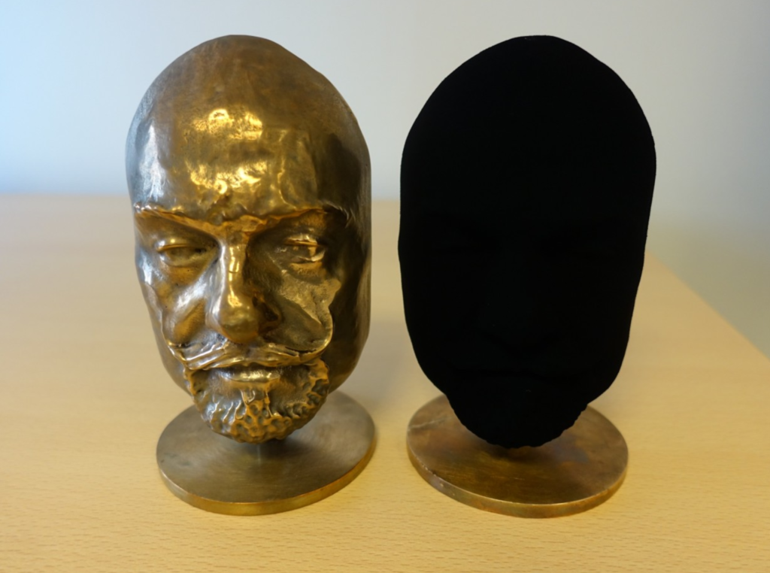
Blackbody radiation
All object with a temperature above 0 K emit energy as emr
A blackbody is a theoretical ideal object that absorbs and emits all frequencies of emr ‘perfectly’
Some real objects approach blackbody behaviour – vantablack, black holes
It is useful to model the behaviour of stars and planets as blackbodies

Slide 39
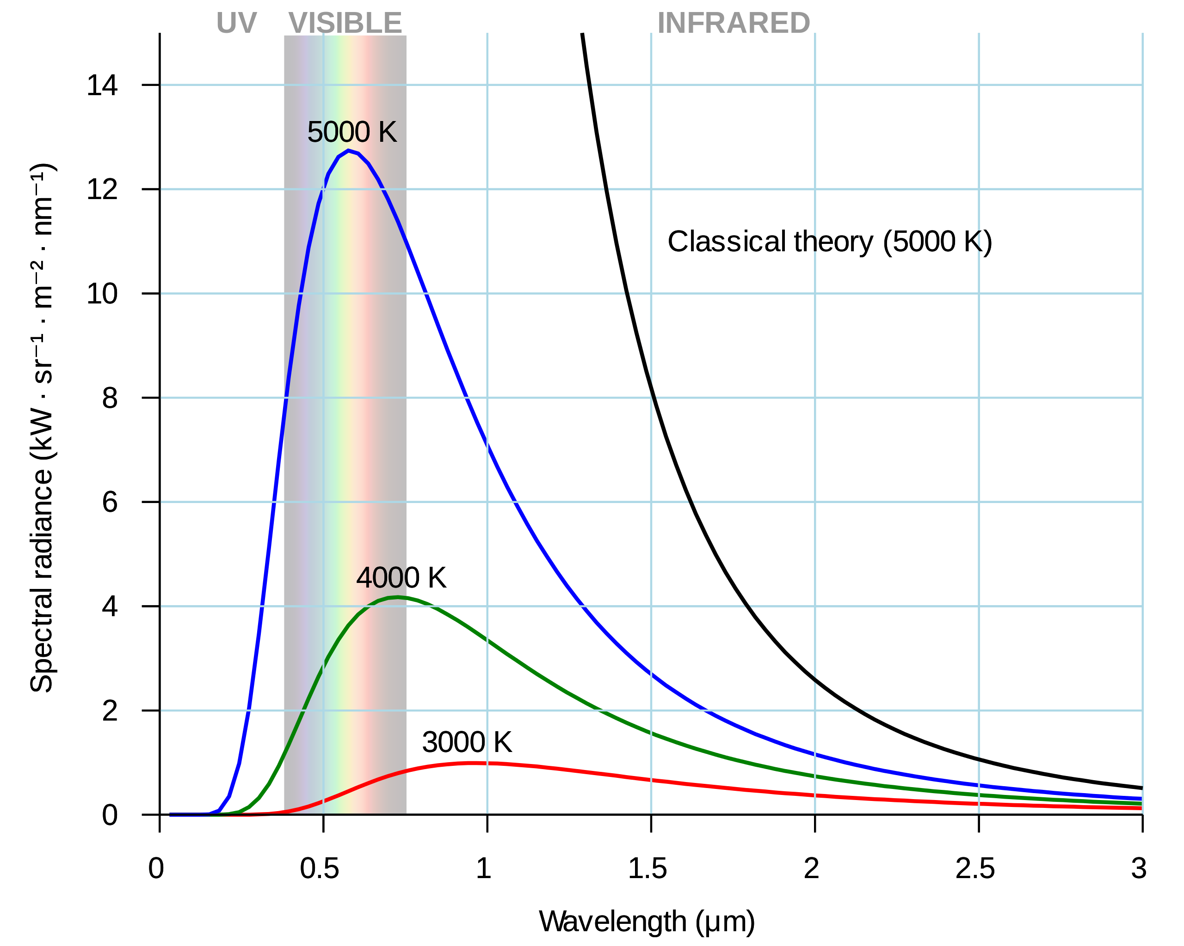
Blackbody radiation spectrum
Blackbody radiation is always a range of different frequencies
The intensity of different frequencies varies only with temperature
As the temperature of the blackbody increases, the dominant wavelength emitted decreases – the dominant frequency increases
This is why heated objects (including stars) first glow red-hot, then white-hot and finally blue-hot
The total energy emitted (area under the curve) increases dramatically with temperature
Classical theories (shown in black) could not match the empirical evidence (red, green and blue) – intensity of light emitted approaches infinity as wavelength approaches 0 – UV catastrophe

Slide 40
Planck to the (accidental) rescue
Desperate to devise a mathematical model that matched the empirical observations Planck tried quantizing light
By making it so only discrete values are allowed for quantity of energy, the mathematical models could now match the empirical observations
Light could no longer be a true spectrum where any quantity of energy was possible
Important to note that this quantization is so fine that at the large scale it is fine to treat it as a continuous spectrum
Wave or particle? – Quantization isn’t compatible with our classical understanding of waves – so is light a particle?

Slide 41
Example
An experiment was conducted to observe changes in colour and intensity as a bar of dull grey tungsten metal was heated from room temperature.
When heated to 200 °C the tungsten is observed as remaining grey and dull. When heated to 700 °C the tungsten is observed as red and dull, and at 2700 °C the tungsten is observed as white and bright.
a) Describe why the colour and intensity of the tungsten changes as it is heated.
The colour changes because the peak wavelength decreases as temperature increases. The intensity increase because the total emitted radiation increases dramatically as temperature increases.
The tungsten is heated further until it starts melting at approximately 3400 °C
b) Sketch a labelled graphs of intensity against wavelength for the two observed spectra at 2700 °C and 3400 °C.

Slide 42
Quantized vs continuous light
Continuous
For a certain frequency – any energy is possible
Energy changed by varying the amplitude of the wave
low energy high energy
Quantized
For a certain frequency – the energy must be an integer multiple of a certain quantity
Energy changed by changing the number of particles of light (photons)
low energy high energy

Slide 43
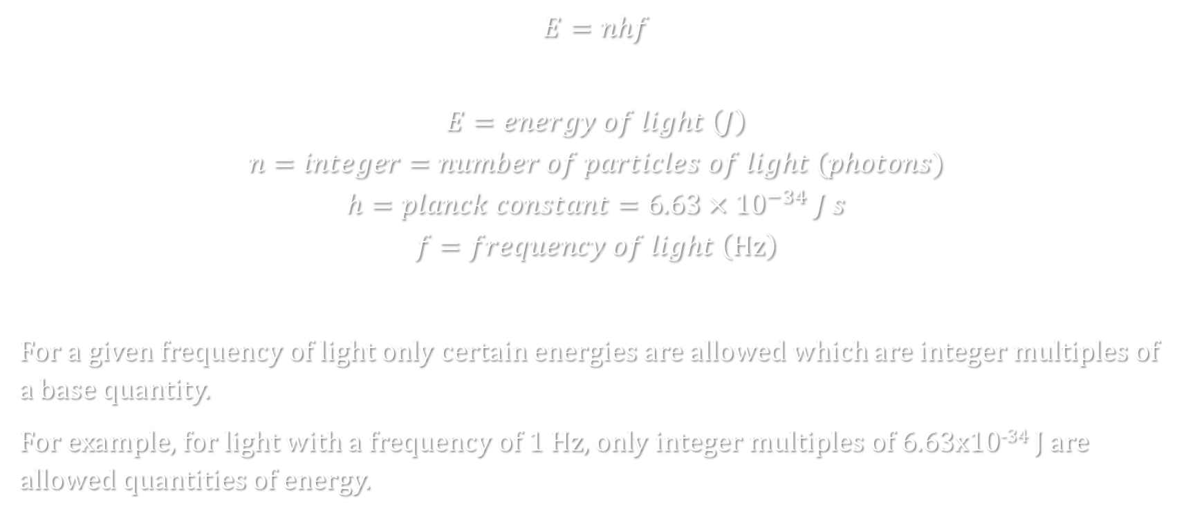
Planck-Einstein relation
$$E=nhf$$
$$E=energy of light \left(J\right)$$
$$n=integer=number of particles of light (photons)$$
$$h=planck constant=6.63×{10}^{−34} J s$$
$$f=frequency of light \left(Hz\right)$$
For a given frequency of light only certain energies are allowed which are integer multiples of a base quantity.
For example, for light with a frequency of 1 Hz, only integer multiples of 6.63x10⁻³⁴ J are allowed quantities of energy.

Slide 44
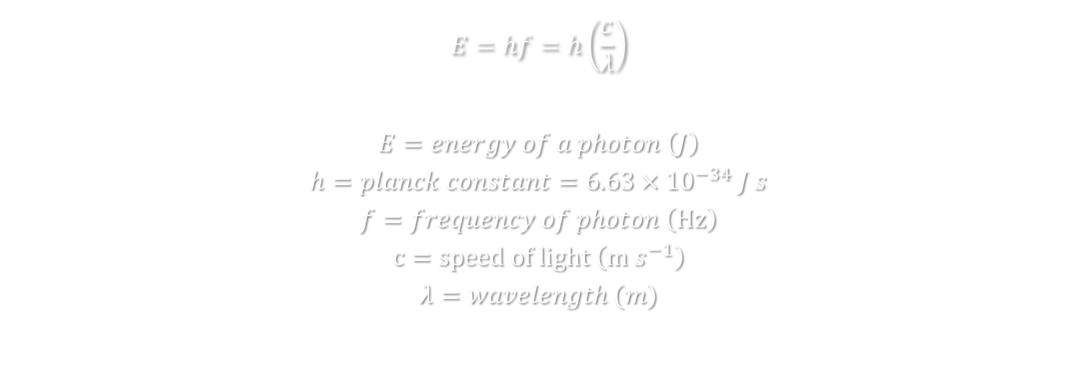
Planck-Einstein relation – energy of a single photon
$$E=hf=h\left(\frac{c}{λ}\right)$$
$$E=energy of a photon \left(J\right)$$
$$h=planck constant=6.63×{10}^{−34} J s$$
$$f=frequency of photon \left(Hz\right)$$
$$c=speed of light \left(m s^{−1}\right)$$
$$λ=wavelength (m)$$

Slide 45
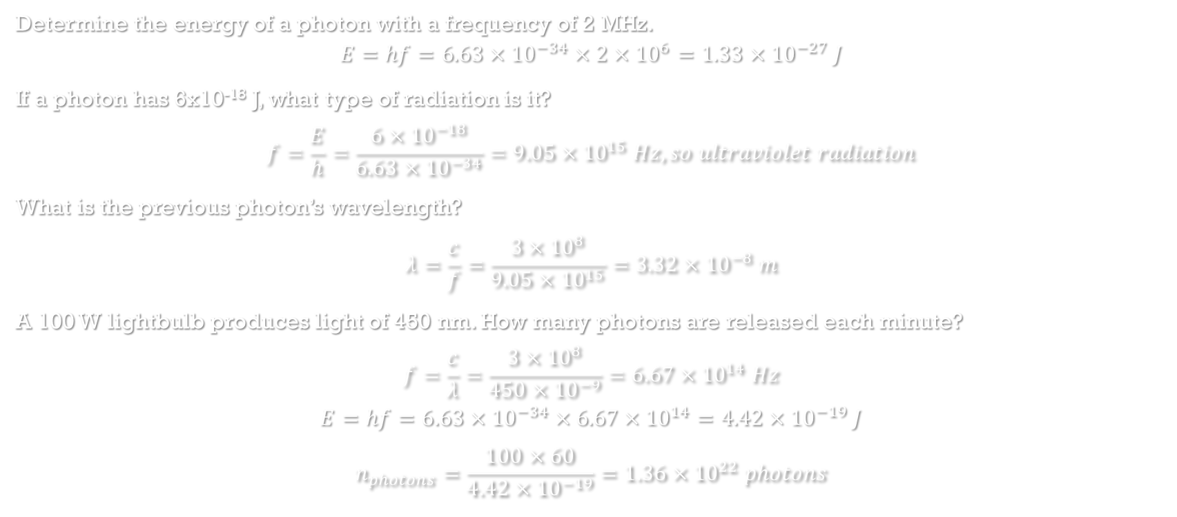
Examples
Determine the energy of a photon with a frequency of 2 MHz.
$$E=hf=6.63×{10}^{−34}×2×{10}^{6}=1.33×{10}^{−27} J$$
If a photon has 6x10⁻¹⁸ J, what type of radiation is it?
$$f=\frac{E}{h}=\frac{6×{10}^{−18}}{6.63×{10}^{−34}}=9.05×{10}^{15} Hz, so ultraviolet radiation$$
What is the previous photon’s wavelength?
$$λ=\frac{c}{f}=\frac{3×{10}^{8}}{9.05×{10}^{15}}=3.32×{10}^{−8} m$$
A 100 W lightbulb produces light of 450 nm. How many photons are released each minute?
$$f=\frac{c}{λ}=\frac{3×{10}^{8}}{450×{10}^{−9}}=6.67×{10}^{14} Hz$$
$$E=hf=6.63×{10}^{−34}×6.67×{10}^{14}=4.42×{10}^{−19} J$$
$$n_{photons}=\frac{100×60}{4.42×{10}^{−19}}=1.36×{10}^{22} photons$$

Slide 46
Photoelectric effect – insufficient energy
When light strikes metal (can be any substance but easiest to observe in metals) under the right conditions, electrons are ejected from the surface of the metal – referred to as photoelectrons
Interpretation is that electrons are given enough energy to break free from their electrostatic attraction to the nucleus
If it isn’t working should just have to increase the energy delivered by the light
Increasing the intensity of light classically thought to increase the amplitude of the wave which increases the energy carried by the wave – the light should then have enough energy to eject electrons, but it doesn’t work
Light shone on metal – no electrons ejected
Brighter light shone on metal – still no electrons ejected
Even brighter light shone on metal – still no electrons ejected

Slide 47
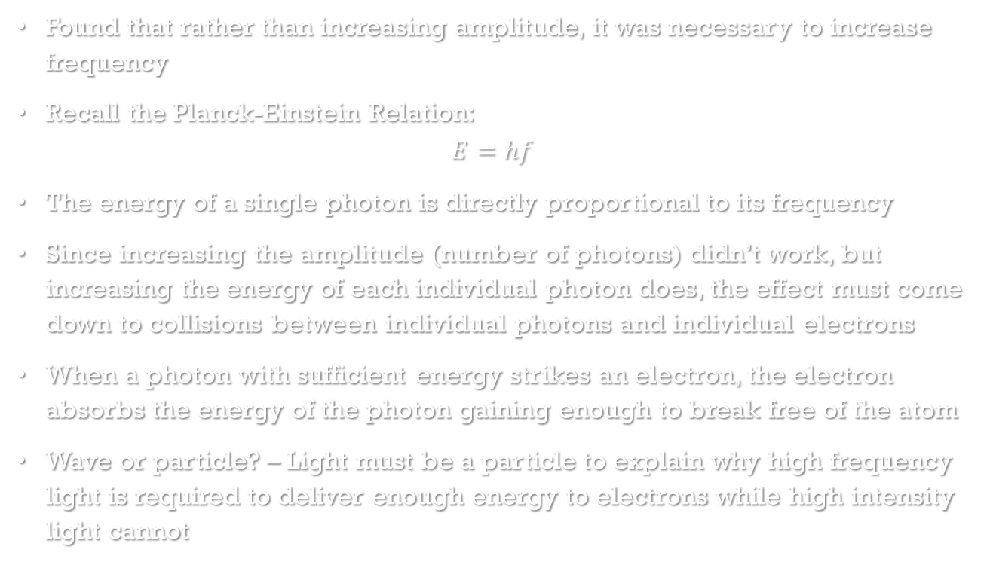
Photoelectric effect – enough energy
Found that rather than increasing amplitude, it was necessary to increase frequency
Recall the Planck-Einstein Relation:
$$E=hf$$
The energy of a single photon is directly proportional to its frequency
Since increasing the amplitude (number of photons) didn’t work, but increasing the energy of each individual photon does, the effect must come down to collisions between individual photons and individual electrons
When a photon with sufficient energy strikes an electron, the electron absorbs the energy of the photon gaining enough to break free of the atom
Wave or particle? – Light must be a particle to explain why high frequency light is required to deliver enough energy to electrons while high intensity light cannot
Light shone on metal – no electrons ejected
Higher frequency light shone on metal – slow moving electrons ejected
Even higher frequency light shone on metal – high speed electrons ejected

Slide 48
Threshold frequency
Threshold frequency (f₀) – minimum frequency needed to eject an electron – corresponds to the smallest binding energy of an electron (referred to as work function)
Below f₀ literally no electrons are emitted
At or above f₀ electron emission is instantaneous – there is no need for electrons to cumulatively gain energy
At or above f₀ the rate of electron emission increases with increasing intensity
At or above f₀ the maximum kinetic energy of emitted electrons increases with increasing frequency

Slide 49
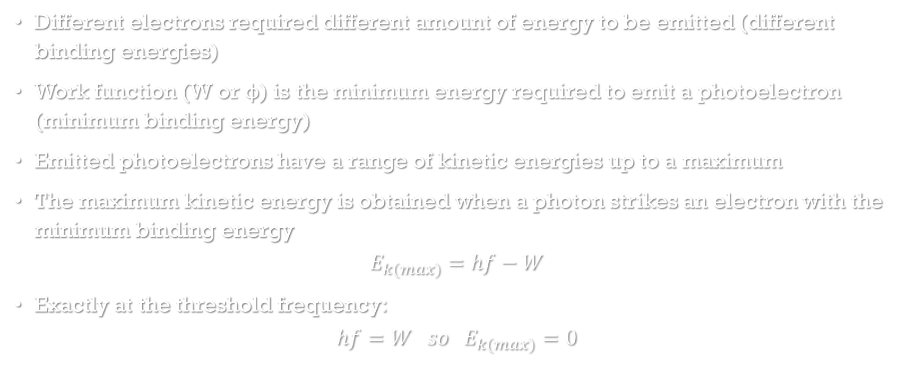
Work function and Kinetic energy of photoelectrons
Different electrons required different amount of energy to be emitted (different binding energies)
Work function (W or φ) is the minimum energy required to emit a photoelectron (minimum binding energy)
Emitted photoelectrons have a range of kinetic energies up to a maximum
The maximum kinetic energy is obtained when a photon strikes an electron with the minimum binding energy
$$E_{k(max)}=hf−W$$
Exactly at the threshold frequency:
$$hf=W so E_{k(max)}=0$$

Slide 50
Measuring photoelectric effect
+
-
Emitted photoelectrons can be attracted to a positively charged plate
Two parallel plates with a voltage across them will accelerate photoelectrons from the negative plate towards the positive plate allowing a current to flow
This current increases with voltage across the plates up to a limit – at this limit all emitted photoelectrons are being collected so there cannot be any further increase in current
Increasing the intensity of the light will increase the maximum current as more photoelectrons are being emitted
Note: still get some current at 0 voltage from the photoelectrons that happen to be emitted in the right direction
A

Slide 51
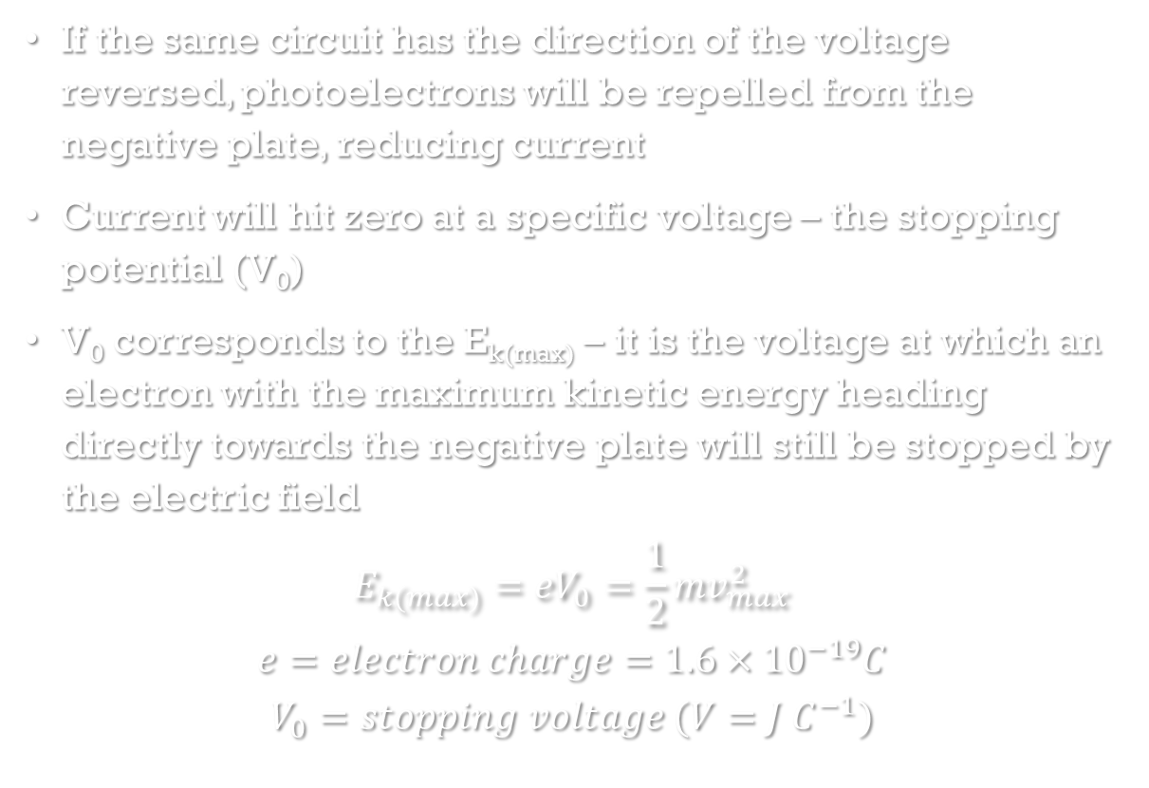
Stopping potential
-
+
If the same circuit has the direction of the voltage reversed, photoelectrons will be repelled from the negative plate, reducing current
Current will hit zero at a specific voltage – the stopping potential (V₀)
V₀ corresponds to the E_{k(max)} – it is the voltage at which an electron with the maximum kinetic energy heading directly towards the negative plate will still be stopped by the electric field
$$E_{k(max)}=eV_{0}=\frac{1}{2}mv_{max}^{2}$$
$$e=electron charge=1.6×{10}^{−19}C$$
$$V_{0}=stopping voltage (V=J C^{−1})$$
A

Slide 52
I/V graphs – varying parameters
Increasing frequency of the light increases the magnitude of V₀
Increasing the intensity of the light increases the maximum current

Slide 53
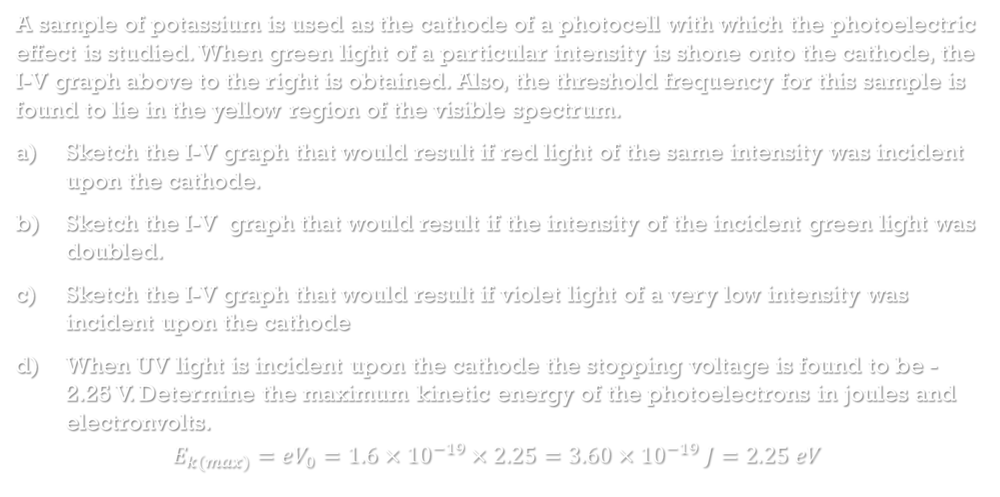
Example
I
V
I
A sample of potassium is used as the cathode of a photocell with which the photoelectric effect is studied. When green light of a particular intensity is shone onto the cathode, the I-V graph above to the right is obtained. Also, the threshold frequency for this sample is found to lie in the yellow region of the visible spectrum.
Sketch the I-V graph that would result if red light of the same intensity was incident upon the cathode.
Sketch the I-V graph that would result if the intensity of the incident green light was doubled.
Sketch the I-V graph that would result if violet light of a very low intensity was incident upon the cathode
When UV light is incident upon the cathode the stopping voltage is found to be -2.25 V. Determine the maximum kinetic energy of the photoelectrons in joules and electronvolts.
$$E_{k(max)}=eV_{0}=1.6×{10}^{−19}×2.25=3.60×{10}^{−19} J=2.25 eV$$
V
I
V
I
V

Slide 54
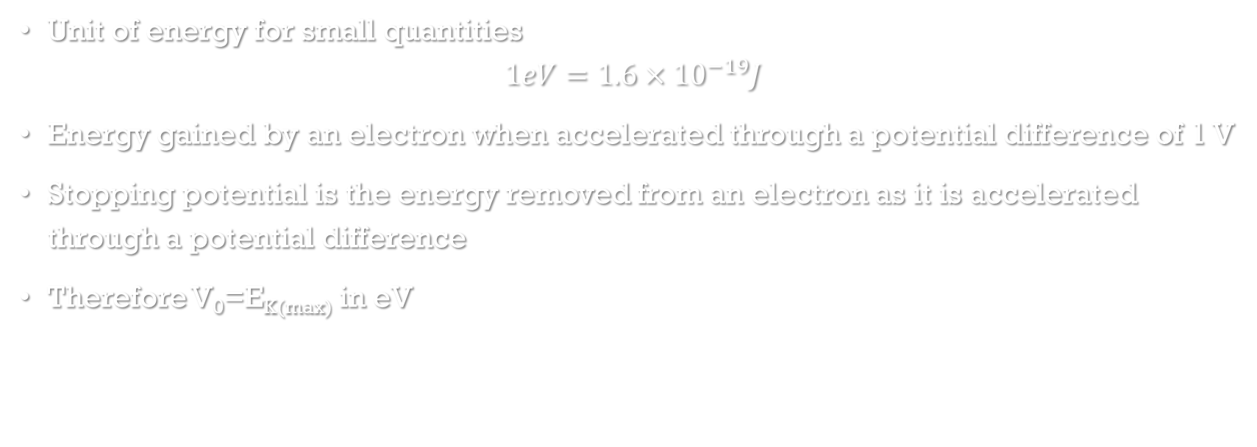
Note on electron Volts
Unit of energy for small quantities
$$1eV=1.6×{10}^{−19}J$$
Energy gained by an electron when accelerated through a potential difference of 1 V
Stopping potential is the energy removed from an electron as it is accelerated through a potential difference
Therefore V₀=E_{K(max)} in eV

Slide 55
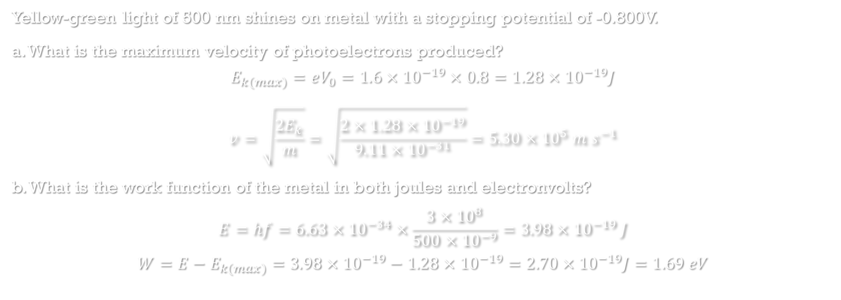
Example
Yellow-green light of 500 nm shines on metal with a stopping potential of -0.800V.
a. What is the maximum velocity of photoelectrons produced?
$$E_{k(max)}=eV_{0}=1.6×{10}^{−19}×0.8=1.28×{10}^{−19}J$$
$$v=\sqrt{\frac{2E_{k}}{m}}=\sqrt{\frac{2×1.28×{10}^{−19}}{9.11×{10}^{−31}}}=5.30×{10}^{5} m s^{−1}$$
b. What is the work function of the metal in both joules and electronvolts?
$$E=hf=6.63×{10}^{−34}×\frac{3×{10}^{8}}{500×{10}^{−9}}=3.98×{10}^{−19} J$$
$$W=E−E_{k(max)}=3.98×{10}^{−19}−1.28×{10}^{−19}=2.70×{10}^{−19}J=1.69 eV$$

Slide 56
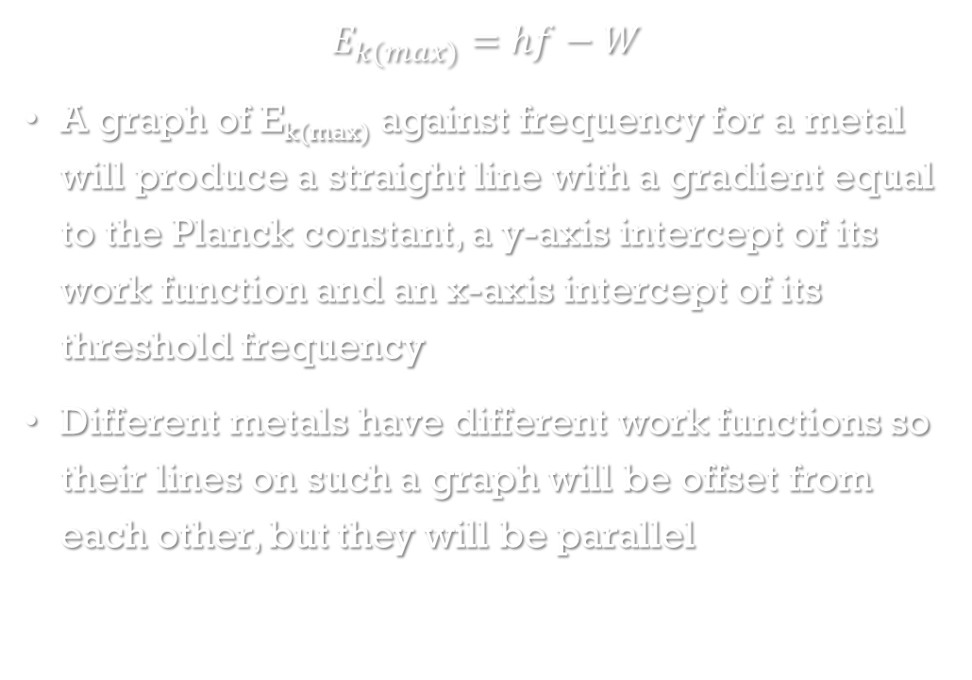
Max E_{K} against frequency
$$E_{k(max)}=hf−W$$
A graph of E_{k(max)} against frequency for a metal will produce a straight line with a gradient equal to the Planck constant, a y-axis intercept of its work function and an x-axis intercept of its threshold frequency
Different metals have different work functions so their lines on such a graph will be offset from each other, but they will be parallel

Slide 57
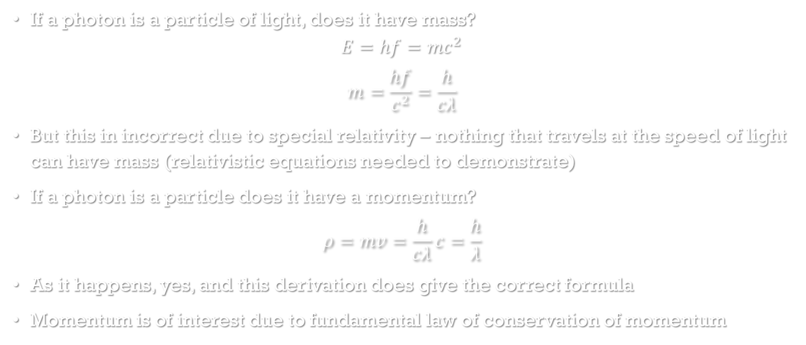
Photon mass? Photon momentum?
If a photon is a particle of light, does it have mass?
$$E=hf=mc^{2}$$
$$m=\frac{hf}{c^{2}}=\frac{h}{cλ}$$
But this in incorrect due to special relativity – nothing that travels at the speed of light can have mass (relativistic equations needed to demonstrate)
If a photon is a particle does it have a momentum?
$$ρ=mv=\frac{h}{cλ}c=\frac{h}{λ}$$
As it happens, yes, and this derivation does give the correct formula
Momentum is of interest due to fundamental law of conservation of momentum

Slide 58
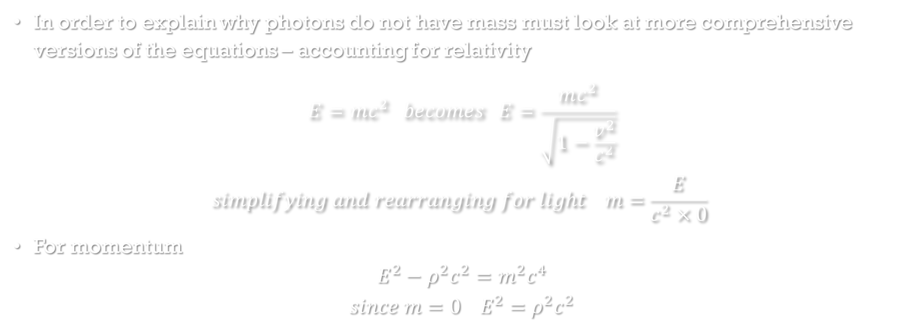
Sidebar – Why momentum but not mass?
In order to explain why photons do not have mass must look at more comprehensive versions of the equations – accounting for relativity
$$E=mc^{2} becomes E=\frac{mc^{2}}{\sqrt{1−\frac{v^{2}}{c^{2}}}}$$
$$simplifying and rearranging for light m=\frac{E}{c^{2}×0}$$
For momentum
$$E^{2}−ρ^{2}c^{2}=m^{2}c^{4}$$
$$since m=0 E^{2}=ρ^{2}c^{2}$$

Slide 59
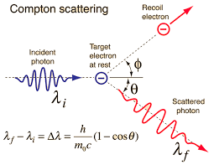
Compton scattering
In the photoelectric effect a photon’s energy is completely absorbed by an electron ejecting it from an atom
If extremely high energy photons are used (e.g. X-rays) it is also possible for an electron to only absorb some of the photon’s energy – due to very large energy electron behaves as a free electron
(E _{γ}>>W)
Essentially a collision between a photon and a free electron – electron sent off at an angle, photon also continues at an angle with a longer wavelength
Wave or particle? – If light were a wave, no change in the photon wavelength would be expected, instead we observe conservation of momentum as if two particles are colliding

Slide 60
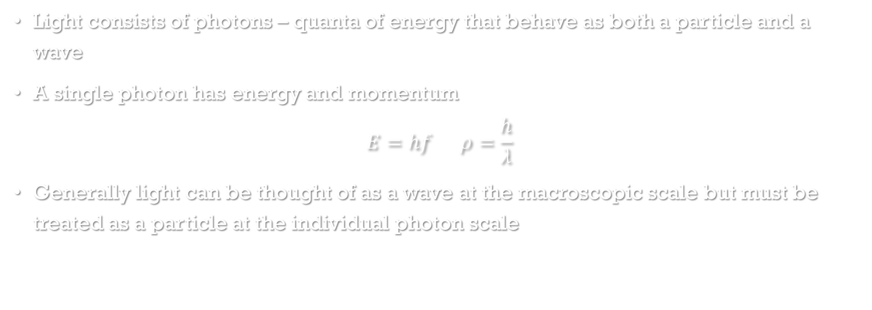
Nature of light summary
Light consists of photons – quanta of energy that behave as both a particle and a wave
A single photon has energy and momentum
$$E=hf ρ=\frac{h}{λ}$$
Generally light can be thought of as a wave at the macroscopic scale but must be treated as a particle at the individual photon scale

Slide 61
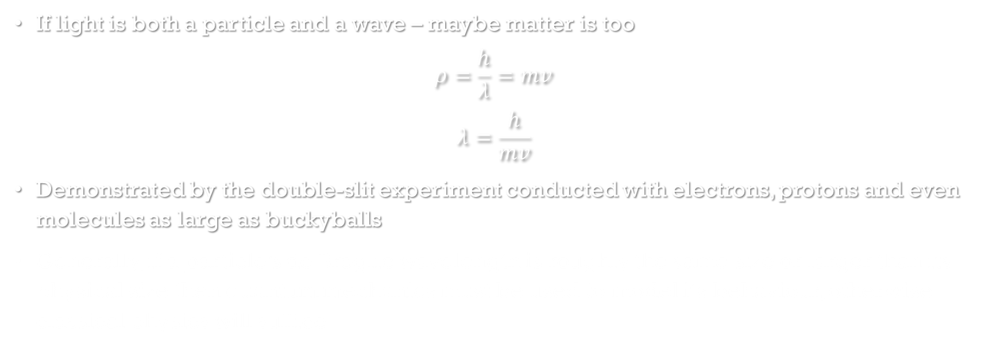
De Broglie wavelength
If light is both a particle and a wave – maybe matter is too
$$ρ=\frac{h}{λ}=mv$$
$$λ=\frac{h}{mv}$$
Demonstrated by the double-slit experiment conducted with electrons, protons and even molecules as large as buckyballs
Generally, if a particle’s de Broglie wavelength is roughly the same size or larger than its physical size then quantum mechanics must be used to model its behaviour, otherwise classical physics will suffice

Slide 62
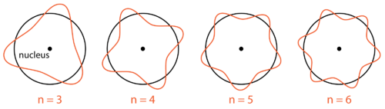
Electron energy level as standing waves
If an electron ‘orbits’ a nucleus as a standing wave it is stable – no loss of energy over time
Electrons as standing waves can only have certain wavelengths and therefore certain energies to exist in orbitals - explains quantization of energy levels
A wavelengths is only allowed if an integer multiple of it matches the circumference of the ‘orbit’

Slide 63
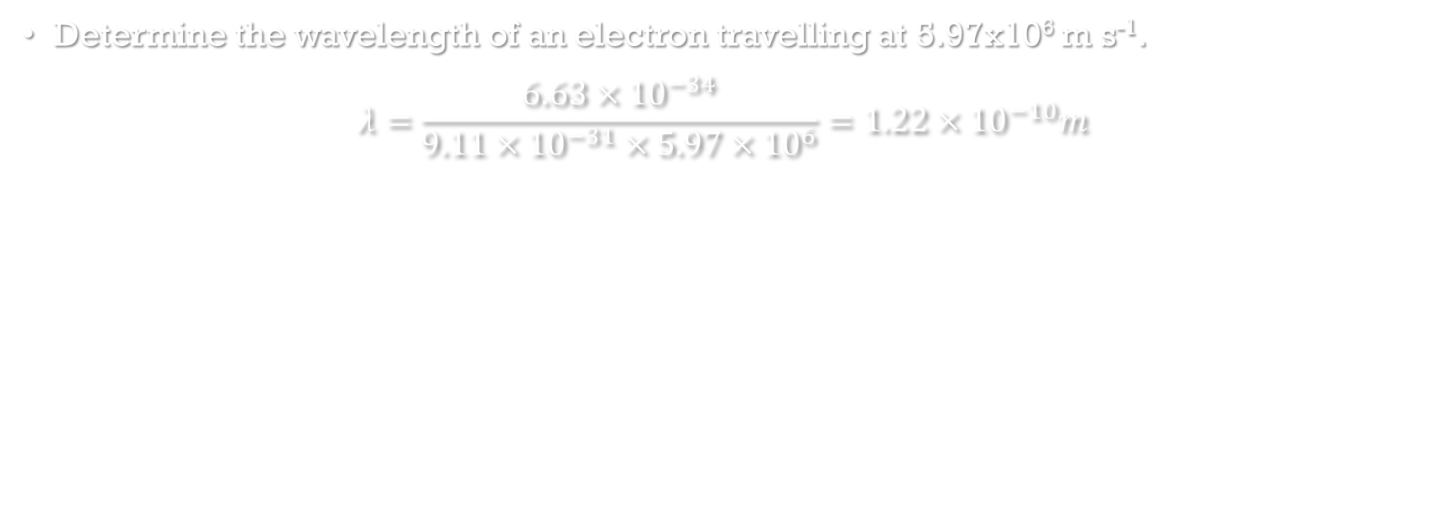
Example
Determine the wavelength of an electron travelling at 5.97x10⁶ m s⁻¹.
$$λ=\frac{6.63×{10}^{−34}}{9.11×{10}^{−31}×5.97×{10}^{6}}=1.22×{10}^{−10}m$$

Slide 64
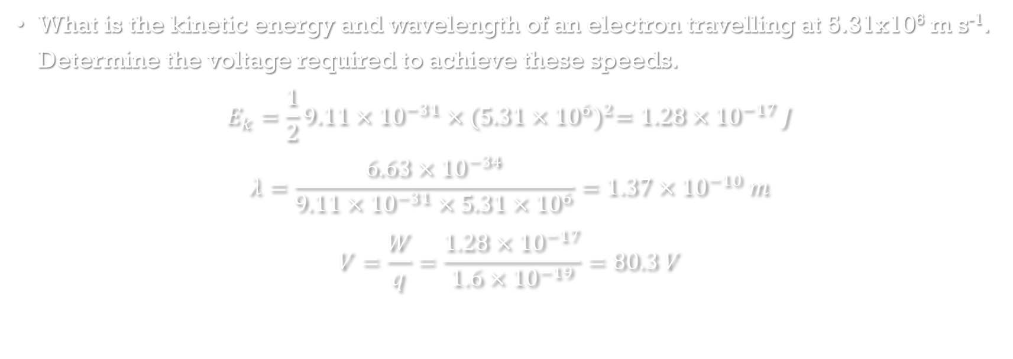
Example
What is the kinetic energy and wavelength of an electron travelling at 5.31x10⁶ m s⁻¹. Determine the voltage required to achieve these speeds.
$$E_{k}=\frac{1}{2}9.11×{10}^{−31}×{(5.31×{10}^{6})}^{2}=1.28×{10}^{−17} J$$
$$λ=\frac{6.63×{10}^{−34}}{9.11×{10}^{−31}×5.31×{10}^{6}}=1.37×{10}^{−10} m$$
$$V=\frac{W}{q}=\frac{1.28×{10}^{−17}}{1.6×{10}^{−19}}=80.3 V$$

Slide 65
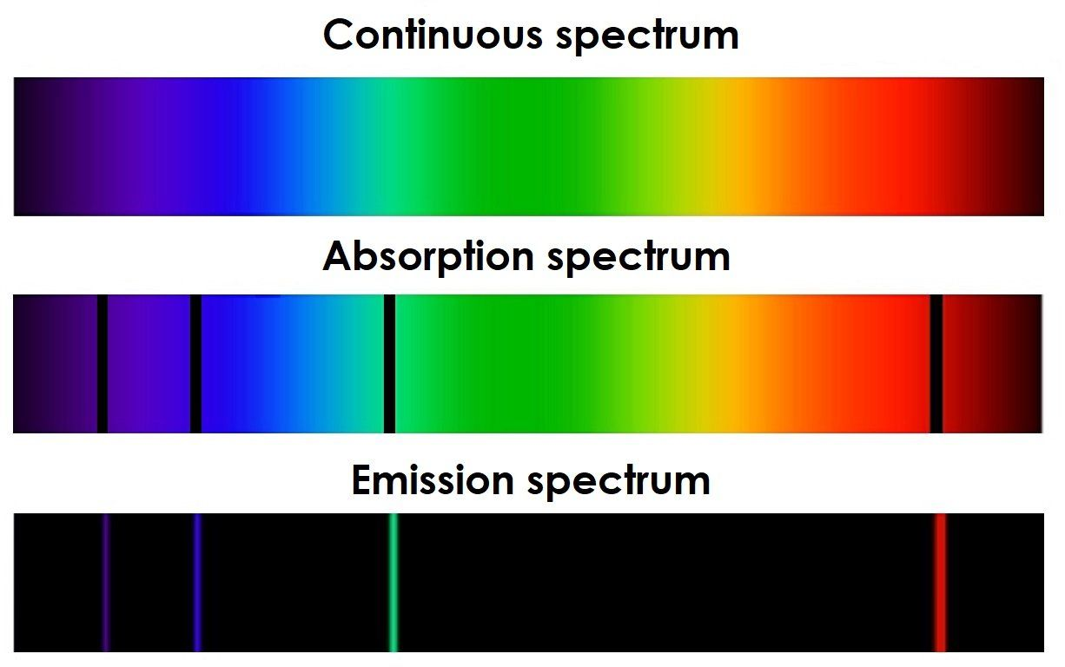
Application of quantized light – atomic absorption and emission
We have pinned down that light is quantized
This can be used to explain both atomic emission and atomic absorption
Atomic absorption: specific elements absorb specific colours of light
Atomic emission: specific elements emit specific colours of light

Slide 66
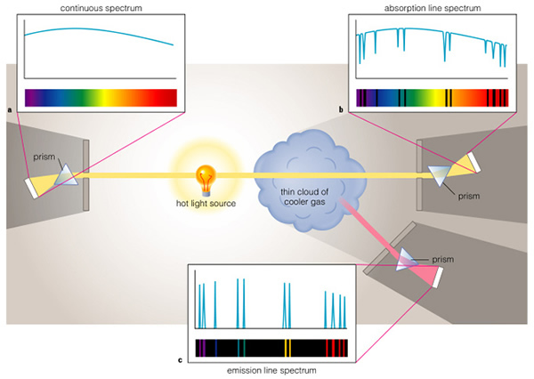
Basic generation of spectra

Slide 67
Emission vs absorption
Atomic emission | Atomic absorption
Atoms of an element supplied with energy (e.g. electrical or thermal) emit light | Atoms of an element absorb light that is shone through them
Light typically emitted from heated gas | Light typically absorbed as it passes through cool gas
Only specific colours of light are emitted | Only specific colours of light are absorbed
The specific colours are unique to each element | The specific colours are unique to each element
The specific colours an element emits are mostly* the exact same colours that element will absorb | The specific colours an element absorbs are the exact same colours that element will emit
*There can be more emission lines than absorption lines due to transitions involving energy levels that don’t ordinarily contain electrons
Spectrum appears as lines of colour on a black background | Spectrum appears as lines of black on a rainbow background
The larger the element, the greater the number of specific colours that are emitted | The larger the element, the greater the number of specific colours that are absorbed

Slide 68


Slide 69
Understanding absorption and emission – atomic structure
Something must be occurring in the atoms – need to understand atomic structure
Simplest model suitable for explaining this phenomenon is the Bohr model
Nucleus of positive protons and neutral neutrons containing almost all the mass “orbited” by negatively charged electrons
Electrons orbit at specific energy levels commonly referred to as shells – electrons may not orbit between specific energy levels – their energy is quantised – only specific values are allowed
Electrons orbit at the lowest available energy level and do not lose energy over time

Slide 70
Explaining emission
When an atom gains energy (e.g. from an electrical current or heat) it is possible for individual electrons to gain energy
However, electrons can only exist at specific energy levels – to gain energy an electron must jump to a higher energy level – referred to as an excited state
This is unstable so the electron loses its extra energy to return to the ground state – the energy can’t simply disappear – it is emitted as a photon of light
The initial energy level and the excited energy level both have specific energies so the change in energy is a specific quanta – leading to a specific colour of light
+
+
+

Slide 71
Explaining Absorption
When light shines through atoms (typically as a gas) individual photons collide with individual electrons
If the energy of the photon is exactly the right amount to jump the electron up to a higher energy level then the photon will be completely absorbed – ceasing to exist – and the electron will become excited
Only specific energies/colours of photon are absorbed – all other pass straight through
+
+

Slide 72
incorrect energy for Absorption
If the incident photon has at least enough energy to ionize the electron then the electron will be ejected from the atom, absorbing the photon and gaining any excess energy as kinetic energy
If the incident photon doesn’t have enough for ionization nor the exact right amount of energy to cause a transition then nothing will happen – this is why only specific colours are absorbed
If the energy is supplied by another electron instead of a photon (e.g. due to an electric current) then the electron giving energy does not need to have the exact right amount of energy
The absorbing electron will take as much energy as it needs for a transition leaving the other with the remainder – an electric current very easily excites electrons of any atom

Slide 73
Energy level diagrams -
Overly space consuming to draw energy level as circular orbits – energy level diagram
ionisation
4th excited state n=5
3rd excited state n=4
2nd excited state n=3
1st excited state n=2
Ground state n=1
+

Slide 74
Working with energy level diagrams
electron transitions shown as arrows
energy of energy levels shown as negative values as they are the binding energy for an electron at that level – the energy the electron would have to gain to be removed from the atom
energy levels numbered in order from the lowest energy level – known as the quantum number
n=∞ used to refer to ionisation – the point at which an electron is removed from an atom
ionisation
n = ∞ E = 0 eV
n = 5 E₅ = -0.54 eV
n = 4 E₄ = -0.85 eV
2nd excited state
n = 3 E₃ = -1.51 eV
1st excited state
n = 2 E₂ = -3.4 eV
ground state
n = 1 E₁ = -13.6eV

Slide 75

Working with energy level diagrams
Energy of photons absorbed or emitted can be determined by the energy difference between two energy levels
$$E_{photon}=hf=∆E=E_{n}−E_{m}$$
e.g. an electron relaxing from n=2 to n=1 would emit a photon with 10.2 eV of energy (-3.4 - -13.6)
ionisation
n = ∞ E = 0 eV
n = 5 E₅ = -0.54 eV
n = 4 E₄ = -0.85 eV
2nd excited state
n = 3 E₃ = -1.51 eV
1st excited state
n = 2 E₂ = -3.4 eV
ground state
n = 1 E₁ = -13.6eV

Slide 76

Example
A ground state electron in a hydrogen atom is excited to n=3
a. how many unique energies of photon could be emitted as it relaxes
3
b. determine which (if any) of the emitted photons would be visible
$$E_{3−1}=−1.51−−13.6=12.09 eV=1.93×{10}^{−18}J$$
$$E_{3−2}=−1.51−−3.4=1.89 eV=3.02×{10}^{−19}J$$
$$E_{2−1}=−3.4−−13.6=10.2 eV=1.63×{10}^{−18}J$$
$$f_{3−1}=\frac{1.93×{10}^{−18}}{6.63×{10}^{−34}}=2.91×{10}^{15} Hz so UV$$
$$f_{3−2}=\frac{3.02×{10}^{−19}J }{6.63×{10}^{−34}}=4.56×{10}^{14} Hz so visible$$
$$f_{2−1}=\frac{1.63×{10}^{−18}}{6.63×{10}^{−34}}=2.46×{10}^{15} Hz so UV$$
ionisation
n = ∞ E = 0 eV
n = 5 E₅ = -0.54 eV
n = 4 E₄ = -0.85 eV
2nd excited state
n = 3 E₃ = -1.51 eV
1st excited state
n = 2 E₂ = -3.4 eV
ground state
n = 1 E₁ = -13.6eV

Slide 77

Lyman, Balmer and Paschen series
groups of transitions in hydrogen ending at the same energy level
Balmer series identified early on because they fall within the visible spectrum
Lyman series creates ultraviolet photons, while the Paschen series creates infrared photons
ionisation
n = ∞ E = 0 eV
n = 5 E₅ = -0.54 eV
n = 4 E₄ = -0.85 eV
2nd excited state
n = 3 E₃ = -1.51 eV
Paschen
1st excited state
n = 2 E₂ = -3.4 eV
Balmer
ground state
n = 1 E₁ = -13.6eV
Lyman

Slide 78


Band spectra
In small atoms the change in energy of transitions is very well defined so the absorption/emission lines are sharp
In larger atoms, and molecules, various factors* can cause small variations in the energy of energy levels – leading to variations in the change in energy of transitions
This creates many different transitions of very similar energies – they blur together appearing as a wider band rather than a line
H
Fe
*temperature, pressure, inhomogeneity (e.g. surface effects), molecular vibration/rotation and even the doppler effect

Slide 79

Gas-DISCHArge lamps
Current flows through plasma exciting electrons in the plasma
Colour of light dependent on the element(s) in the plasma

Slide 80


Atomic emission - FLuorescence
Certain materials glow with unexpected colours when exposed to invisible ultraviolet light – examples of fluorescence
The invisible UV light is absorbed by electrons exciting them
The electrons relax through multiple smaller transitions causing lower energy visible light to be emitted
glow only visible while directly exposed to high energy light

Slide 81

Fluorescent lights
Similar to gas discharge lamp – current through gas causes atomic emission
However the emission from mercury is UV light - this is used to trigger fluorescence in a phosphor coating on the walls of the light
The phosphor is a mix of different fluorescent substance which together produce enough different colours of light to appear white – not really a continuous spectrum like daylight

Slide 82


Slide 83

Atomic emission - Phosphorescence
Similar to normal atomic emission but with a time delay
Excited electron gets ‘stuck’ in excited state for as much as a couple of hours
Allows energy to be stored in phosphorescent material which will slowly emit light over minutes – glow in the dark materials

Slide 84

Lasers
Light amplification by stimulated emission of radiation
Normal light sources create light of many different colours, all travelling in random directions and with no particular phase relationship between photons
Lasers in contrast are said to be ‘coherent’, which encompasses a few ideas:
all photons have same wavelength/frequency/colour/energy
all travelling in same direction so maintains very
narrow beam over enormous distances
all in phase

Slide 85

How do lasers work?
Normally when an excited electron relaxes, the photon is emitted in a random direction – spontaneous emission
If a photon of the right energy passes by an excited electron it can trigger the relaxation and emission, in this case the emitted photon travels in the exact same directions as the stimulating photon and perfectly in phase with the stimulating photon – stimulated emission
This takes you from one initial photon to two
which can each stimulate further emission
– creates a cascade chain reaction
– light amplification
Just need to start with a collection of excited
atoms

Slide 86

applied spectra
Since each element has a unique absorption/emission spectrum, these spectra can be used to identify elements
Used to determine the chemical composition of stars
A star should emit a continuous spectrum
Different types of star have had different colours absorbed from their spectrum by elements in their outer layers

Slide 87
Example
H
Use the diagrams to the right to determine which spectral classes of star (O, B, A, F, G, K and/or M) contain H in their outer layers?
O, B, A, F & G
Which contain He in their outer layers?
F, G, K & M
He

Slide 88


Doppler shift of absorption spectra
atomic absorption leads to very characteristic absorption patterns
When looking at distant stars the familiar pattern is recognizable but it appears in the wrong place – shifted towards the red
The further away the star is the more it is redshifted – expanding universe
Caused by doppler effect – a wave source moving away from an observer results in waves of increased wavelength (more red) so the entire spectrum is shifted

Slide 89

Summary of stellar spectra
Stars are a long way away – light is by far the best way to gain information about them
Most information about stars comes from interpretation of the absorption spectra
Information | Evidence
Chemical composition | Characteristic absorption lines
Temperature | Blackbody spectral profile
Relative velocity | Degree of doppler shift of absorption lines
Rotational motion | Smearing of absorption lines due to varying doppler shift

Slide 90

Photovoltaic cells – solar panels
The basics:
Join between two different semiconductors creates persistent electric field due to local charge separation
Incident photon excites electron from immobile ground state (valence band) to a higher energy level where electrons can move (conduction band)
The excited electron leaves behind an ‘electron hole’ or just ‘hole’ – vacancy for an electron – can be thought of as a positive particle
The electric field pushes the electron to one end of the cell and the hole to the other
Overall result is a small flow of current – many cells can combine to produce useful amounts of DC

Slide 91

Understanding semiconductors – electrons bands
In a single atom energy levels have single defined energies
In a solid array of many atoms (metal/covalent network) no
two energy levels may have exactly the same energy so the
levels of each atom change slightly – resulting in a very large
number of very similar energy levels – effectively becomes a
continuous band of allowed energies
In metals there are partially filled bands, the room allows for easy movement of electrons – conduction
In non-metals the valence band is full – no room for movement – insulator
In non-metals if electrons could become excited up from the valence band to the next band up (conduction band) they could conduct but there is a very large energy gap (band gap)
In semi-conductors this band gap is relatively small, allowing for conduction under the right circumstances

Slide 92




n and P semiconductors
n-type (doped with electron donor)
increased number of electrons in conduction band, small number of holes in the valence band
electrons as primary charge carriers
e.g. silicon doped with phosphorous
p-type (doped with electron acceptor)
increased number of holes in the valence band, small number of electrons in the conduction band
holes as primary charge carriers
e.g. silicon doped with boron

Slide 93

p-n junctions
Junction between n-type and p-type semiconductors
electrons diffuse from n to p due to concentration gradient – holes diffuse p to n
holes and mobile electrons combine at junction cancelling out – depletion zone (no charge carriers)
n-type side becomes positively charges due to lost electrons – p-type side becomes negatively charged due to lost holes
charge separation at the boundary leading to an electric field pushing electrons back the opposite way – prevents process from spreading further
dynamic equilibrium

Slide 94
light emitting diodes (LEDs)
The simple version:
Junction of two different semiconductors
n-type holds high energy electrons (similar to excited electrons but actually stable)
p-type holds electron holes in a lower energy level
Stable until a voltage is applied
With enough voltage the electrons from the n-type semiconductor are pushed across to the p-type where they relax into the holes releasing the excess energy as light of a wavelength specific to the energy level gap

Slide 95

light emitting diodes (LEDs) - detail
similar to photovoltaic cells – makes use of p-n junctions – almost the same process in reverse
high energy (conduction band) electrons from the n-type semiconductor are pushed by an external voltage across to the p-type semiconductor where they combine with low energy (valence band) holes
This is a transition down in energy so the excess energy is released as a photon with a specific energy equivalent to the band gap (difference between energy level bands)

Slide 96

Colour of lEDs
Initially monochromatic determined by band gap – large band gap = more blue
Can use phosphors in the housing to convert down to lower energy colours to create a mixture of colours – white light
Blue LEDs are most versatile in that sense
– highest energy so other visible colours can be
created
However blue LEDs require the largest band gap
which makes them harder to make – tend to break

Slide 97
LEDs pros and cons
Pros | Cons
Much more energy efficient than older light sources | Harder to use with dimmers
Much longer lifespan | Tend to decrease in brightness over their lifespan
Less waste heat | Can fail prematurely in high temperatures
More physically durable
Increasingly affordable
Good at directional light

Slide 98
LEDs and Photovoltaic cells summary
LEDs | Photovoltaic cells
n-type semiconductor contains trapped, excited electrons | electric field naturally occurring in n-p junction would push electrons from the p-type semiconductor to the n-type semiconductor
p-type semiconductor contains holes that the electrons can relax into | p-type semiconductor does not contain electrons in the conduction band where they could move, so no current flows
electric field naturally occurring in n-p junction prevents electrons and holes recombining | incident light excites valence band electron in p-type to the conduction band where it can move
external voltage can push the excited electrons against the field allowing them to relax and emit light based on the band gap | electron current flows from p-type to n-type pushed by electric field

Slide 99
X-ray radiation
X-rays very useful due to high penetration ability:
Used in medical imaging
Detecting flaws/wear in metals and joins e.g. welds in airplane fuselage
X-ray crystallography – used to determine detailed structure of crystals from diffraction pattern (λ≈bond length)
2 main types:
Characteristic radiation – a few specific wavelengths specific to the element being used
Brehmsstrahlung – continuous spectrum of x-ray wavelengths up to a maximum energy

Slide 100

X-ray Vacuum tube
Current through tungsten filament heats – causes thermionic emission of electrons into vacuum
Voltage (≈50 kV) across the two electrodes accelerated the electrons towards the target
Accelerated electrons bombard tungsten target
- ~99% of energy becomes heat but ~1% can
become x-rays through certain interactions with
tungsten anode

Slide 101





Characteristic radiation
High energy free electron strikes inner shell electron in an atom giving it enough energy to eject it from the atom
An electron from a higher energy level relaxes to fill the vacancy – releases excess energy as a photon
Exact amount of energy determined by element (characteristic), if large enough energy it will be an x-ray
Essentially atomic emission

Slide 102

Brehmsstrahlung
(braking radiation)
When a charged particle is decelerated by passing by another charged particle it emits electromagnetic radiation to satisfy conservation of energy
If the deceleration is large enough, then high energy radiation including x-rays can be emitted

Slide 103


Energy of Brehmsstrahlung
If the decelerated particles loses all its kinetic energy (direct collision with nucleus) this creates the maximum energy photon – there is a maximum energy (minimum wavelength)
Maximum energy depends on accelerating voltage
if V=50 kV, then E_{max}=50 keV
More normally a particle will lose its energy through multiple steps leading to wide range of possible energies with less than the maximum being most prevalent – continuous spectrum up from the minimum wavelength
The closer the electron passes to the nucleus the greater the deceleration

Slide 104

Typical x-ray spectrum

Slide 105

Example
An x-ray tube is set up with a potential difference of 80 kV. Determine the maximum energy, maximum frequency and minimum wavelength of photon that can be emitted?
$$E_{max}=80 keV=80000×1.6×{10}^{−19}=1.28×{10}^{−14}J$$
$$f=\frac{E}{h}=\frac{1.28×{10}^{−14}}{6.63×{10}^{−34}}=1.93×{10}^{19} Hz$$
$$λ=\frac{c}{f}=\frac{3×{10}^{8}}{1.93×{10}^{19}}=1.55×{10}^{−11} m$$

Slide 106
Example
an X-ray tube with a molybdenum target has a potential difference of 50.0 kV . Calculate the:
Max kinetic energy of bombarding electrons in eV and J.
Max energy of emitted photons in J.
Max speed of bombarding electrons.
Max frequency of emitted X-rays
Minimum wavelength of emitted photons.
Photon energy of a characteristic emission (0.6 x 10⁻¹⁰m) in J and eV.
a) 8 x 10⁻¹⁵J b) 8 x 10⁻¹⁵J c) 1.33 x 10⁸ms-1 d) 1.2 x 10¹⁹Hz
e) 2.49 x 10⁻¹¹m f) 3.32 x 10⁻¹⁵J

